Slide 1
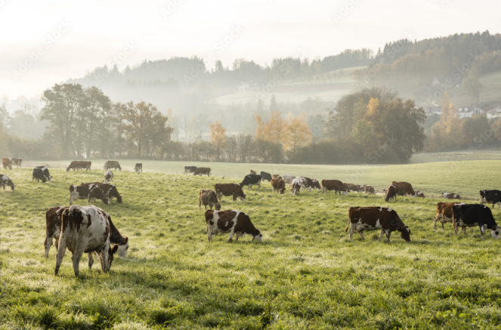
3rd Quarter-2023
October 17, 2023
Focus Topic:
Risk Management/Income & Revenue Protection

Slide 2
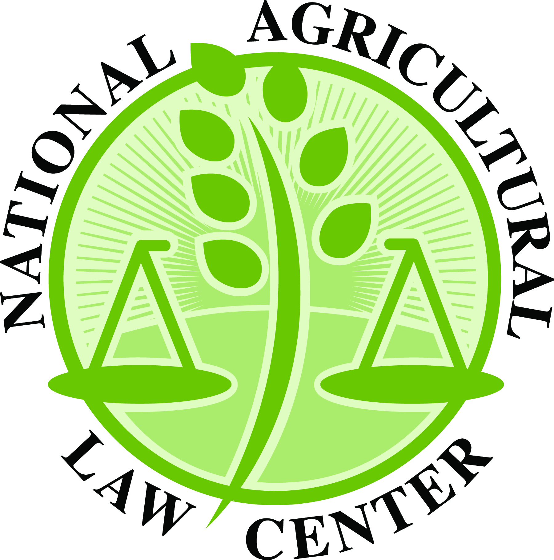
Thanks to Our Partners
The Center for Agricultural and Shale Law is a partner of the National Agricultural Law Center (NALC) at the University of Arkansas System Division of Agriculture, which serves as the nation’s leading source of agricultural and food law research and information. This material is provided as part of that partnership and is based upon work supported by the National Agricultural Library, Agricultural Research Service, U.S. Department of Agriculture.

Slide 3
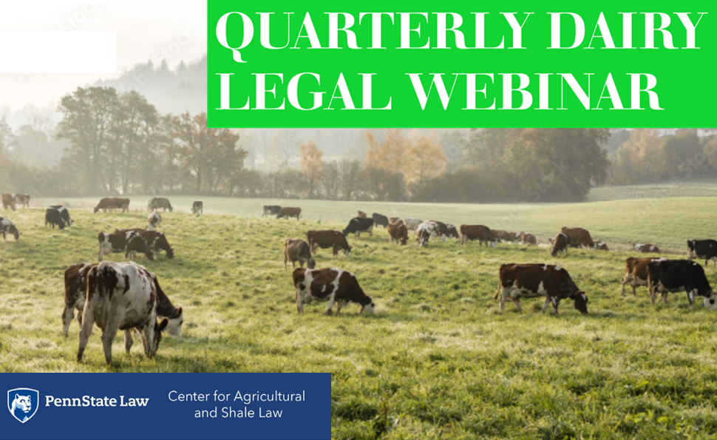
Quarterly Dairy Legal Webinar Series
#13 in the series – covering the 3rd quarter of 2023
Find upcoming webinars in this series here
April 2023 Quarterly Dairy Legal Webinar Part 2: International Dairy Trade
January 2023 Quarterly Dairy Legal Webinar: Interstate Regulation of Milk Production and Processing
October 2022 Quarterly Dairy Legal Webinar: 2023 Farm Bill and the Potential Implications for the Dairy Industry
July 2022 Quarterly Dairy Legal Webinar: Labeling Standards
April 2022 Quarterly Dairy Legal Webinar Part 2: Animal Welfare
February 2022 Quarterly Dairy Legal Webinar Part 2: Dairy Industry Carbon Reduction Programs
December 2021 Quarterly Dairy Legal Webinar Part 2: USDA’s Pandemic Assistance Programs
July 2021 Quarterly Dairy Legal Webinar: Geographical Indications
April 2021 Quarterly Dairy Legal Webinar: Federal Milk Marketing Order Reform
January 2021 Quarterly Dairy Legal Webinar Part 2: International Trade with Becky Rasdall
November 2020 Quarterly Dairy Legal Webinar Part 2: Federal Milk Marketing Order 51

Slide 4
https://aglaw.psu.edu/quarterly-dairy-legal-webinar/

Slide 5
HOUSEKEEPING
This webinar will be recorded.
Use the Q&A feature for questions.
CLE credits:
Link will be posted in the chat
Please fill out form
Listen for code word
Questions?
Email: aet17@psu.edu

Slide 6
3rd Quarter – 2023
October 17, 2023
Round Up – 3rd Quarter 2023

Slide 7
USDA ERS Published Dairy Econometric Model
On July 13, 2023, the U.S. Department of Agriculture (USDA) Economic Research Service (ERS) published its Annual U.S. Dairy Sector Econometric Model.
A tool used by the USDA Dairy Interagency Commodity Estimates Committee (ICEC) to forecast U.S. milk and dairy product supply, demand, and prices over the next 10 years.
Support the USDA Agricultural Projections annual report
USDA Agricultural Projections to 2032
Analyzes market conditions and evaluates the impact of federal policies on the dairy sector.
Key findings:
Milk supply remains relatively resistant to price fluctuations.
Dairy producers do not significantly alter their milk production in response to shifts in milk prices.

Slide 8
USDA Proposed Rule Amending Appalachian, Southeast, Florida Federal Milk Marketing Orders
On July 18, 2023, the U.S. Department of Agriculture (USDA) published proposed rule changes for Appalachian, Southeast, and Florida Federal Milk Marketing Orders (FMMOs) (88 FR 46016).
Proposed changes to Transportation Credit Balancing Fund (TCBF)
Update mileage rate calculation
Adjust months of mandatory and discretionary payment
Revise non-reimbursed mileage factor
Increase maximum assessment rate for Class I milk
Proposed introduction of Distributing Plant Delivery Credits (DPDC)
Credit determination based on location and delivery criteria
Safeguards to prevent excess assessment collections
Measures to deter unwarranted milk movements for DPDC payments.

Slide 9
USDA AMS Held Hearing on Federal Milk Marketing Order (FMMO) Reform
On August 23, 2023, the U.S. Department of Agriculture (USDA) Agricultural Marketing Service (AMS) commenced its first hearing on Federal Milk Marketing Order (FMMO) reform.
Testimony and evidence on proposals to amend the pricing formula for all eleven FMMOs
The AMS is considering 21 proposals
Proposals revolve around milk composition, commodity products, Class III and IV formulas, base Class I skim milk price, and Class I and Class II differentials.
Hearing progress
The hearing recessed on October 11, 2023
The hearing will reconvene on November 27, 2023, in Zionsville, Illinois.
Read weekly summaries at National Milk Producers Federation Hearing Updates webpage.
Watch at: www.zoomgov.com/j/1604805748

Slide 10
USDA FSA Established Milk Loss Program for 2020, 2021, and 2022 Disaster Events
On September 11, 2023, the U.S. Department of Agriculture (USDA) Farm Service Agency (FSA) established the Milk Loss Program; provides financial assistance to farmers affected by qualifying natural disasters (e.g., droughts, wildfires, hurricanes, floods, etc.) in 2020, 2021, and 2022.
Eligibility criteria
Dairy farmers must submit a monthly application for milk loss due to disasters
Payment calculation
Based on average daily milk production and fair market value of lost milk
Payment factor
90% for beginning farmers, limited resource farmers, socially disadvantaged farmers, or veteran farmers
75% for all other affected farmers
Application deadline
The deadline to apply for the Milk Loss Program was October 16, 2023.

Slide 11
USDA Announced $5 Million for Second Round of Organic Dairy Marketing Assistance Payments
On September 20, 2023, the U.S. Department of Agriculture (USDA) announced a $5 million allocation for the second round of Organic Dairy Marketing Assistance Payments (ODMAP).
First round of payments
USDA provided $15 million to eligible producers
Payment factored by 75%
Second round of payments
Provides the remaining 25% of assistance to each eligible producer
Automatic for actively enrolled program participants
Assistance amount based on the volume of milk marketed in 2022.

Slide 12
USDA AMS Report on Dairy Promotion and Research Programs
On September 25, 2023, the U.S. Department of Agriculture (USDA) Agricultural Marketing Service (AMS) published its 2020 Report to Congress on the Dairy Promotion and Research Program and Fluid Milk Processor Program.
Dairy Promotion and Research Program—collected $346.8 million in assessments in 2020
Fluid Milk Processor Promotion Program—collected $85.7 million in assessments in 2020
Congressmembers called for the publication of the 2020, 2021, and 2022 reports on September 22, 2023.
“We are highly troubled that dairy farmers have been denied access to federally mandated reports detailing the efficacy of programs they must fund. USDA is obligated to provide this information to ensure transparency in how dairy producer’s dollars are spent; by neglecting to fulfill this obligation, USDA risks further eroding farmer’s confidence in important agriculture programs.”

Slide 13
Dairy Margin Coverage (DMC) Payment Update
On September 29, 2023, the U.S. Department of Agriculture (USDA) Farm Service Agency (AMS) announced the eighth consecutive DMC payment for 2023
August 2023 margin triggered eighth payment.
August 2023 Dairy Margin
In August, dairy producers made an average profit of $6.46 per hundredweight (cwt) of milk after covering feed costs.
The USDA is set to distribute $120 million in DMC payments to dairy producers for August.

Slide 14
U.S. EPA and Hershey Co. Announced $2 Million in Funding for Local Dairy Farmers
On August 22, 2023, the U.S. Environmental Protection Agency (EPA) and Hershey Co. pledged $2 million to assist local dairy farmers in Pennsylvania.
“These funds, $1 million of which will be funded by the EPA and a matching $1 million of which will be committed from Hershey, will be used to support the Alliance and Land O’Lakes in implementing agricultural conservation practices on Land O’Lakes member dairy farms. The National Fish and Wildlife Foundation (NFWF) will administer the portion of the funds provided from EPA to the Alliance.”

Slide 15
Methane Emission Reduction Research in California
On July 6, 2023, the California Department of Food and Agriculture (CDFA) initiated the acceptance of pre-proposals for the Livestock Enteric Methane Emission Reduction Research Program (LEMER-RP).
Funded by the California Budget Act of 2022
Total allocation of $10 million for “demonstration trials evaluating additives and dietary modifications that have the potential to reduce enteric methane emissions in the dairy and livestock sectors.
Pre-proposals were due by August 7, 2023
Full proposals are due in early November 2023.

Slide 16
Penn State Study Examining FMMO Pricing Policy Impact within the Chesapeake Bay Watershed
Professors Zeya Zhang and David Abler from Penn State University College of Agricultural Sciences published a study titled “Dairy pricing policy, production, and water quality: Application to the Chesapeake Bay Watershed.”
Research released on May 15, 2023.
Evaluation of dairy pricing policies and their effects on the economy and water quality in the Chesapeake Bay Watershed
Findings:
FMMO pricing change would expand the dairy sector
Limited impact on production from rising livestock feed costs
Net revenue changes varying across regions, with the highest increases in large dairy sectors
Water quality impacts: increased nitrogen emissions and decreased phosphorus emissions.

Slide 17
3rd Quarter – 2023
October 17, 2023
Focus Topic:
Risk Management/Income & Revenue Protection

Slide 18
Agenda : USDA’s risk management and income protection programs for dairy producers. We will not discuss private risk management or price hedging tools.
Dairy Margin Coverage (DMC) program
Dairy Revenue Protection
Livestock Gross Margin—Dairy
Dairy Indemnity Payment Program
Dairy Donation Program
2021 - Market Volatility Assistance Program
2022 - Organic Dairy Marketing Assistance Program (ODMAP)
2023 - Milk Loss Program (MLP)

Slide 19
Dairy Margin Coverage (DMC)
DMC guarantees a desired margin between an established “all-milk price” and an average feed cost. If < $9.50, payments may be made depending up on what coverage has been purchased.
FSA administered (not by USDA-RMS).
FSA DMC Homepage
1st authorized in 2018 Farm Bill. Annual enrollment by January 31 each year. Covers up
DMC Fact Sheet-2022 & Supplemental DMC Fact Sheet-2023
FSA Handbook-DMC (2021)
Notes:
August 2023 Margin Triggered Eighth Dairy Margin Coverage Payment for 2023
On September 29, 2023, the U.S. Department of Agriculture (USDA) Farm Service Agency (FSA) announced that the August milk margin triggered the eighth consecutive payment for dairy producers who obtained Dairy Margin Coverage (DMC) for the 2023 program year. This means that the margin fell below the level that was set for the program in August.
According to the announcement, in August, dairy producers made an average profit of $6.46 per hundredweight of milk after paying for feed. The USDA is also expected to pay out $120 million in Dairy Margin Coverage (DMC) payments to dairy producers in August.

Slide 20
Producers are eligible for catastrophic level margin protection (based on a $4 margin and 95 percent production history coverage) for their dairy operations by paying an annual administrative fee.
Producers are eligible to purchase greater coverage (up to $9.50 margin on 5 to 95 percent of production history) for an annual premium.
Covers production up to 5M lbs. annually.
Supplemental DMC: Consolidated Appropriations Act of 2021 allowed small and mid sized producers (not > 5M annually) a more recent calculation of prod. history (from 2011-13 to 2019) for supplemental eligibility starting for 2021 years and forward (but paid in 2023).
AGI limits do not apply.
USDA’s Database of DMC - historical enrollment, payments, by state, etc.
PA: $96,138,888 total payments; $54,285 avg per operation; 1771 enrolled; 71.8%.

Slide 21
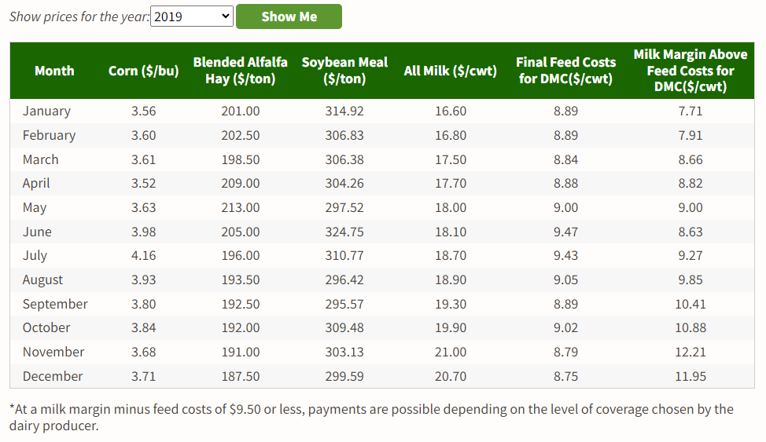

Slide 22
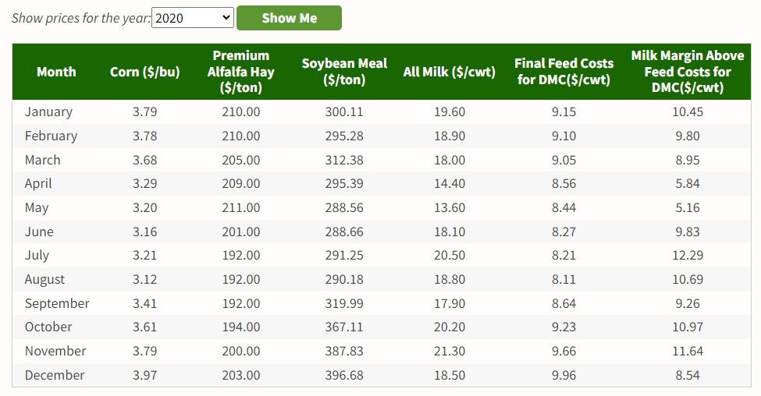

Slide 23
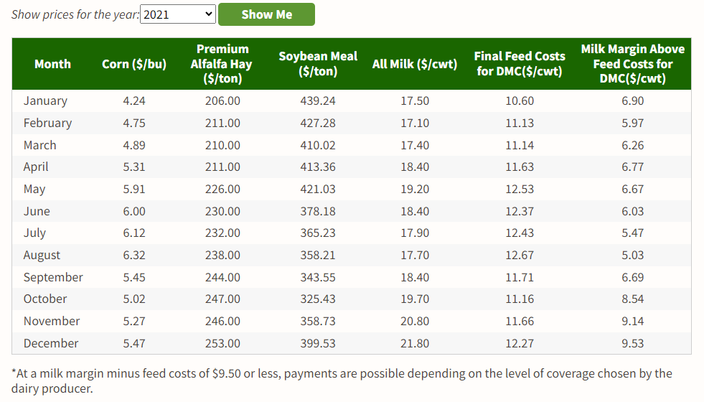

Slide 24
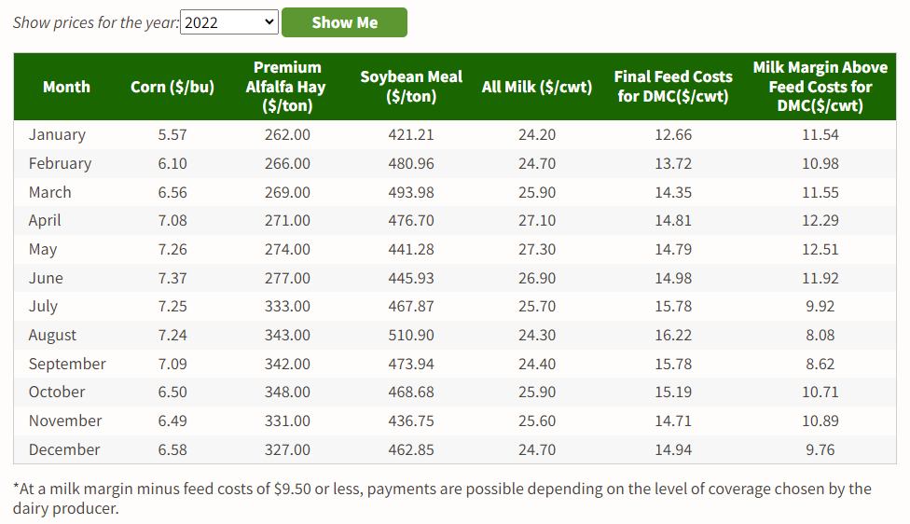

Slide 25
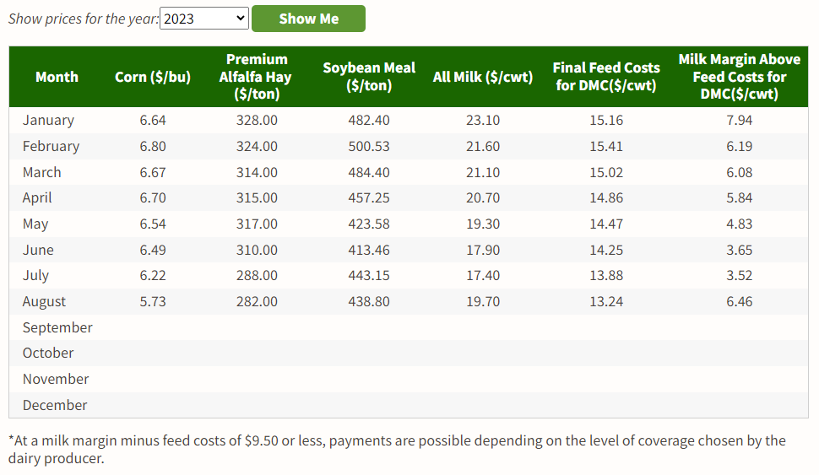

Slide 26
Dairy Revenue Protection (DRP)
Dairy Revenue provides protection against a decline in revenue (yield and/or price) from milk production on a quarterly basis.
RMS administered.
DRP Fact Sheet-2019
DRP FAQs-2020
2023 Policy / 2024 Policy (not available yet?)
2023 Handbook / 2024 Handbook

Slide 27
Dairy Revenue Protection (Dairy-RP) is designed to insure against unexpected declines in the quarterly revenue from milk sales relative to a guaranteed coverage level. The expected revenue is based on futures prices for milk and dairy commodities, and the amount of covered milk production elected by the dairy producer. The covered milk production is indexed to the state or region where the dairy producer is located.
Not covered: Loss/death of cattle; Not a “natural occurrence in market prices.”
Dairy-RP offers two Revenue pricing options:
The Class Pricing Option uses a combination of Class III and Class IV milk prices as a basis for determining coverage and indemnities.
The Component Pricing Option uses the component milk prices for butterfat, protein and other solids as a basis for determining coverage and indemnities. Under this option you may select the butterfat test percentage and protein test percentage to establish your insured milk price.

Slide 28
Livestock Gross Margin-Dairy (LGM-Dairy)
RMS administered. Traditional insurance product, designed for livestock.
LGM Dairy Fact Sheet-2022
LGM Diary FAQs-2022
2023 LGM Dairy Policy / 2024 LGM Dairy Policy
2023 Handbook / 2024 Handbook
Gross margin is the market value of milk minus feed costs. LGM-Dairy uses futures prices for corn, soybean meal, and milk to determine the expected gross margin and the actual gross margin LGM‑Dairy is similar to buying both a call option to limit higher feed costs and a put option to set a floor on milk prices.

Slide 29
Dairy Indemnity Payment Program (DIPP)
Provides payments to dairy producers when a public regulatory agency directs that raw milk be excluded from the commercial market due to contamination: pesticides, nuclear radiation, toxic substances, chemical residues. Manufacturers also eligible only for pesticide contamination.
FSA administered.
PFAS Expansion: Maine (2021); New Mexico (2022)
DIPP Fact Sheet-2018
FSA Handbook-DIPP

Slide 30
Dairy Donation Program (DDP)
Under the Dairy Donation Program (DDP), authorized by the 2021 Consolidated Appropriations Act, $400 million in funding became available to facilitate dairy product donations and reduce food waste. Expired in September 2023.
Under the DDP, eligible dairy organizations can partner with nonprofit feeding organizations that distribute food to individuals and families in need. Those partnerships may apply for and receive reimbursements to cover some expenses related to eligible dairy product donations.
Entities previously enrolled with the existing Milk Donation Reimbursement Program are eligible to receive a supplemental payment on donations made since January 1, 2020, that equals the difference between the DDP and MDRP payment rates. Supplemental payments to qualifying handlers have already been made.
Interim Final Rule (86 FR 48887)

Slide 31
Market Volatility Assistance Program
Losses due to 2018 Class 1 price calculation change and govt. cheese purchases.
August 2021 – Round One: USDA distributed over $250M in pandemic assistance payments to handlers and cooperatives for payment to more than 25,000 eligible dairy farmers who received a lower value due to market abnormalities caused by the pandemic and ensuing Federal policies between July and December 2020. The first round of payments were made on production up to 5 million pounds.
January 2023 – Round Two: USDA made payments to eligible dairy farmers for fluid milk sales between 5 million and 9 million pounds from July through December 2020. Another $100M.
Limitations: Dairy farmers with an eligible 2020 Adjusted Gross Income less than or equal to $900,000, or 75 percent of income was derived from farming, ranching, or forestry-related activities.

Slide 32
Organic Dairy Marketing Assistance Program
$104M for a one-time 2023 cost-share payment to organic producers for projected marketing costs, based upon marketing costs and lbs. marketed in 2022.
“ . . . organic dairy producers facing a unique set of challenges in recent years, including higher costs attributed to the pandemic and drought conditions . . . ODMAP provides immediate support to certified organic dairy operations during 2023 keeping organic dairy operations sustainable until the markets return to more normal conditions.“
FSA webpage
5/19/23 Press Release
ODMAP Fact Sheet-2023
Notes:
The U.S. Department of Agriculture (USDA) Announced $5 Million for Second Round of Organic Dairy Marketing Assistance Payments
On September 20, 2023, the U.S. Department of Agriculture (USDA) provided an additional $5 million to support organic dairy producers through the Organic Dairy Marketing Assistance Program (ODMAP). The USDA has already paid $15 million to eligible producers through the first round of payments.
The amount of assistance is based on the amount of milk the producer marketed in 2022.
The first round of ODMAP payment was factored by 75%, meaning that producers received 75% of the assistance they were eligible for. The second round of payments will provide the remaining 25% of assistance to each eligible producer.
Producers actively enrolled in the program will automatically receive the second ODMAP payment.

Slide 33
Milk Loss Program (2023)
The Milk Loss Program allows eligible dairy operations to receive payments for milk that was dumped or removed without compensation from the commercial milk market due to qualifying weather events that inhibited the delivery of milk or the storage of milk due to disaster events for the 2020, 2021 and 2022 calendar years. Limited to 30 days per each year.
FSA administered; FSA Emergency Relief homepage – Click on “MLP” tile
Fact Sheet
Milk Loss Program and Emergency Relief Program Final Rule (88 FR 62285).
FSA internal Policy Update (10/12/23)
Notes:
The U.S. Department of Agriculture (USDA) Established Milk Loss Program for 2020, 2021, and 2022 Disaster Events
On September 11, 2023, the U.S. Department of Agriculture (USDA) Farm Service Agency (FSA) established a milk loss program to help dairy farmers who lost milk due to natural disasters, such as droughts, wildfires, hurricanes, floods, etc. The program covers milk losses in the years 2020, 2021, and 2022.
To be eligible for the program, dairy farmers must submit an application for each month they had to remove or dump milk from the market due to a natural disaster. The application must include milk marketing statements for the month before and the month of the loss, as well as a written explanation of what happened.
Payments are calculated based on the average daily milk production and the fair market value of the lost milk. The final payment is determined by multiplying the payment calculation by a payment factor. The payment factor is 90% for affected farmers who meet the definition of beginning farmer, limited resource farmer, socially disadvantaged farmer, or veteran farmer, and 75% for all other affected farmers.
The deadline to apply for the Milk Loss Program was October 16, 2023.

Slide 34
The calculation for determining MLP payment is:
(Base period per cow average daily milk production x the number of milking cows in a claim period x the number of days milk was dumped in a claim period) ÷ 100 x pay price per hundredweight (cwt.).
The MLP payment percentage will be 90% for underserved producers, including beginning, limited resource, and veteran farmers and ranchers and 75% for all other producers.
AGI limitation does not apply; Payment Limitation = not > $125,000 in payments under MLP if their average adjusted gross farm income is less than 75% of their average AGI or more than $250,000 if their adjusted gross farm income is at least 75% of their average AGI.
Statutory Authority: Extending Government Funding and Delivering Emergency Assistance Act, P.L. 117-43 - $10B for 2020 & 2021 crop losses, including milk. Disaster Relief Supplemental Appropriations Act, P.L. 117-328 - $3B for 2022 crop losses, including milk.

Slide 35
THANK YOU! PLEASE SUBMIT QUESTIONS!
Brook Duer
Staff Attorney
Center for Agricultural and Shale Law
Penn State Law
329 Innovation Boulevard, Suite 118
University Park, PA 16802
(814) 863-3396
dhd5103@psu.edu
18 years in private practice in Lancaster County
12 years at the Pennsylvania Department of Agriculture (8 years as Chief Counsel)
Penn State Ag Law Center since 2019.

Slide 36
