Slide 1
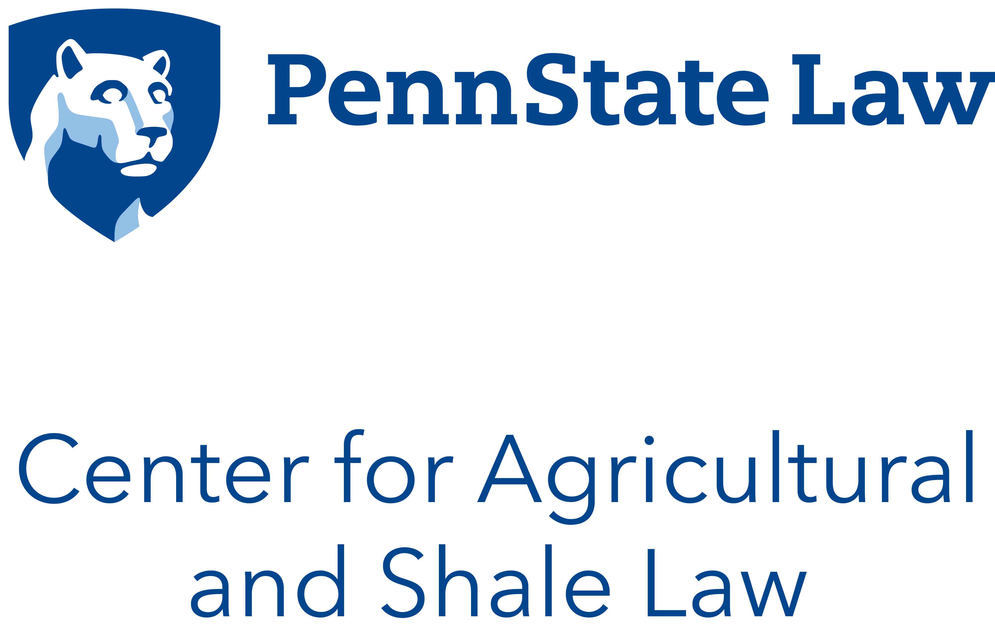

Slide 2
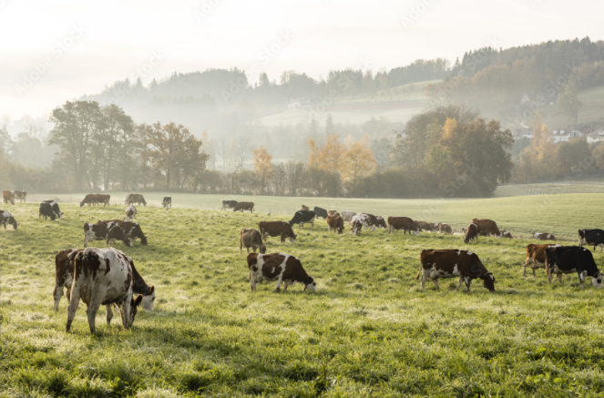
Focus Topic: International Dairy Trade: Canada - U.S. USMCA Arbitration Round 2
1st Quarter – 2023
April 18, 2023

Slide 3
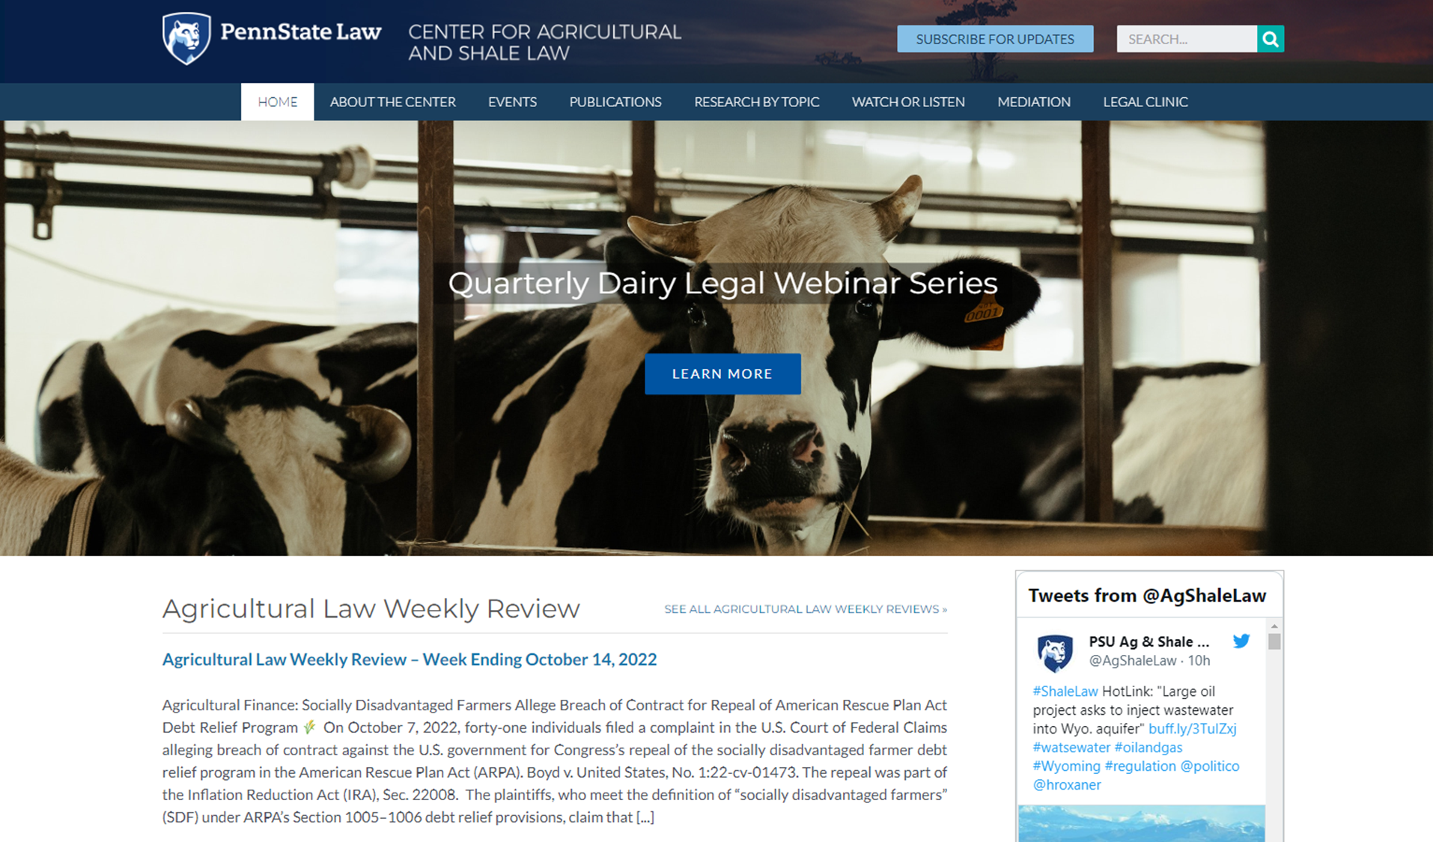
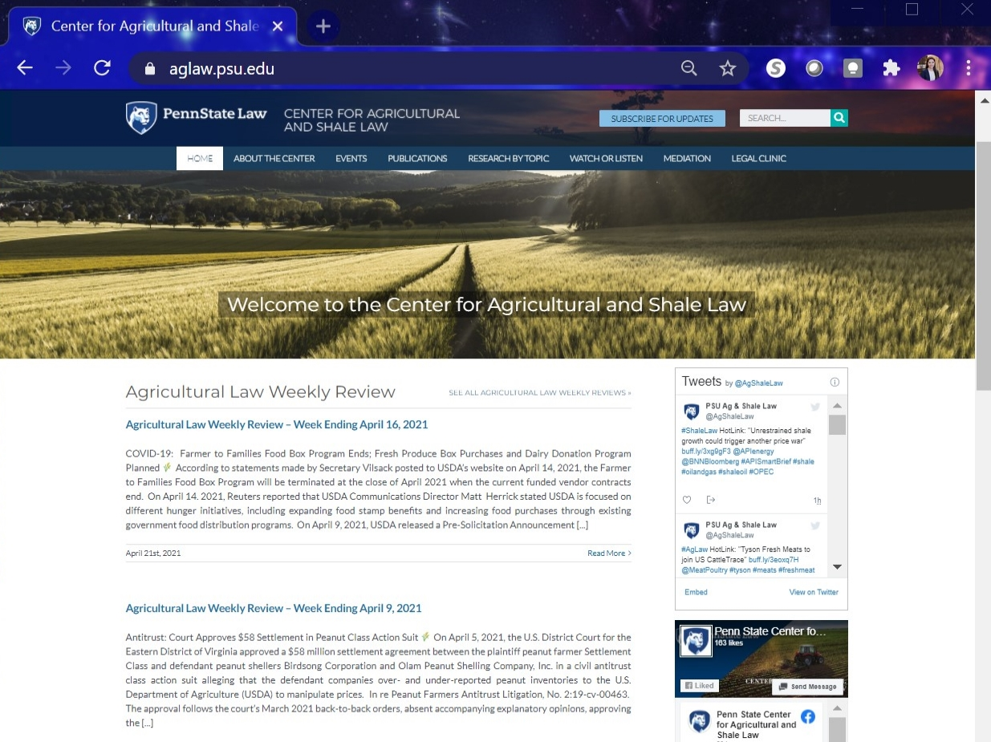

Slide 4
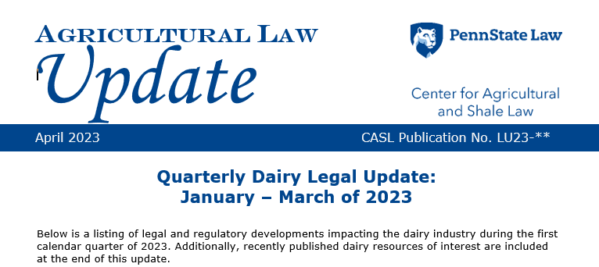
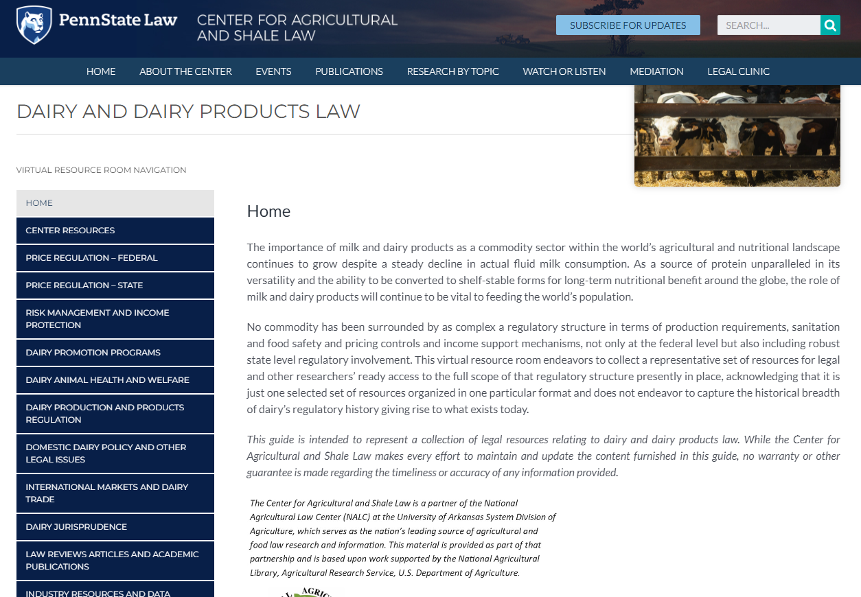
Quarterly Dairy Legal Update
Dairy and Dairy Products Law – Virtual Resource Room
During the second quarter of 2022, the Penn State Center for Agricultural and Shale Law went live with a new Virtual Resource Room titled “Dairy and Dairy Products Law.”

Slide 5
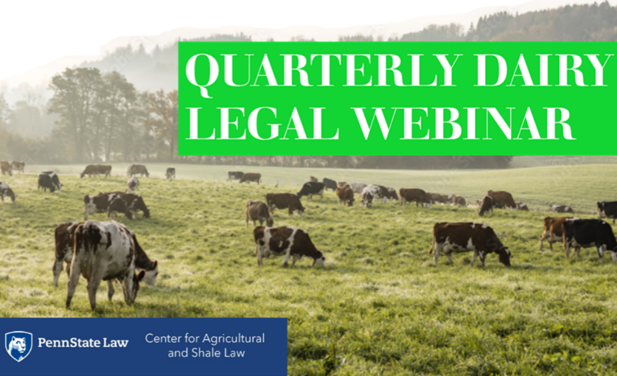
Quarterly Dairy Legal Webinar Series
#11 in the series – covering the 1st quarter of 2023
Link to webinar series webpage

Slide 6
Dairy Quarterly Legal Webinar Series Format
Recent Legal Developments in the Dairy Industry
Focus Topic of Importance to Dairy Industry
Questions

Slide 7
HOUSEKEEPING
This webinar will be recorded.
Use the Q&A feature for questions.
CLE credits:
Link will be posted in the chat
Please fill out form
Listen for code word
Questions?
Email: jks251@psu.edu

Slide 8
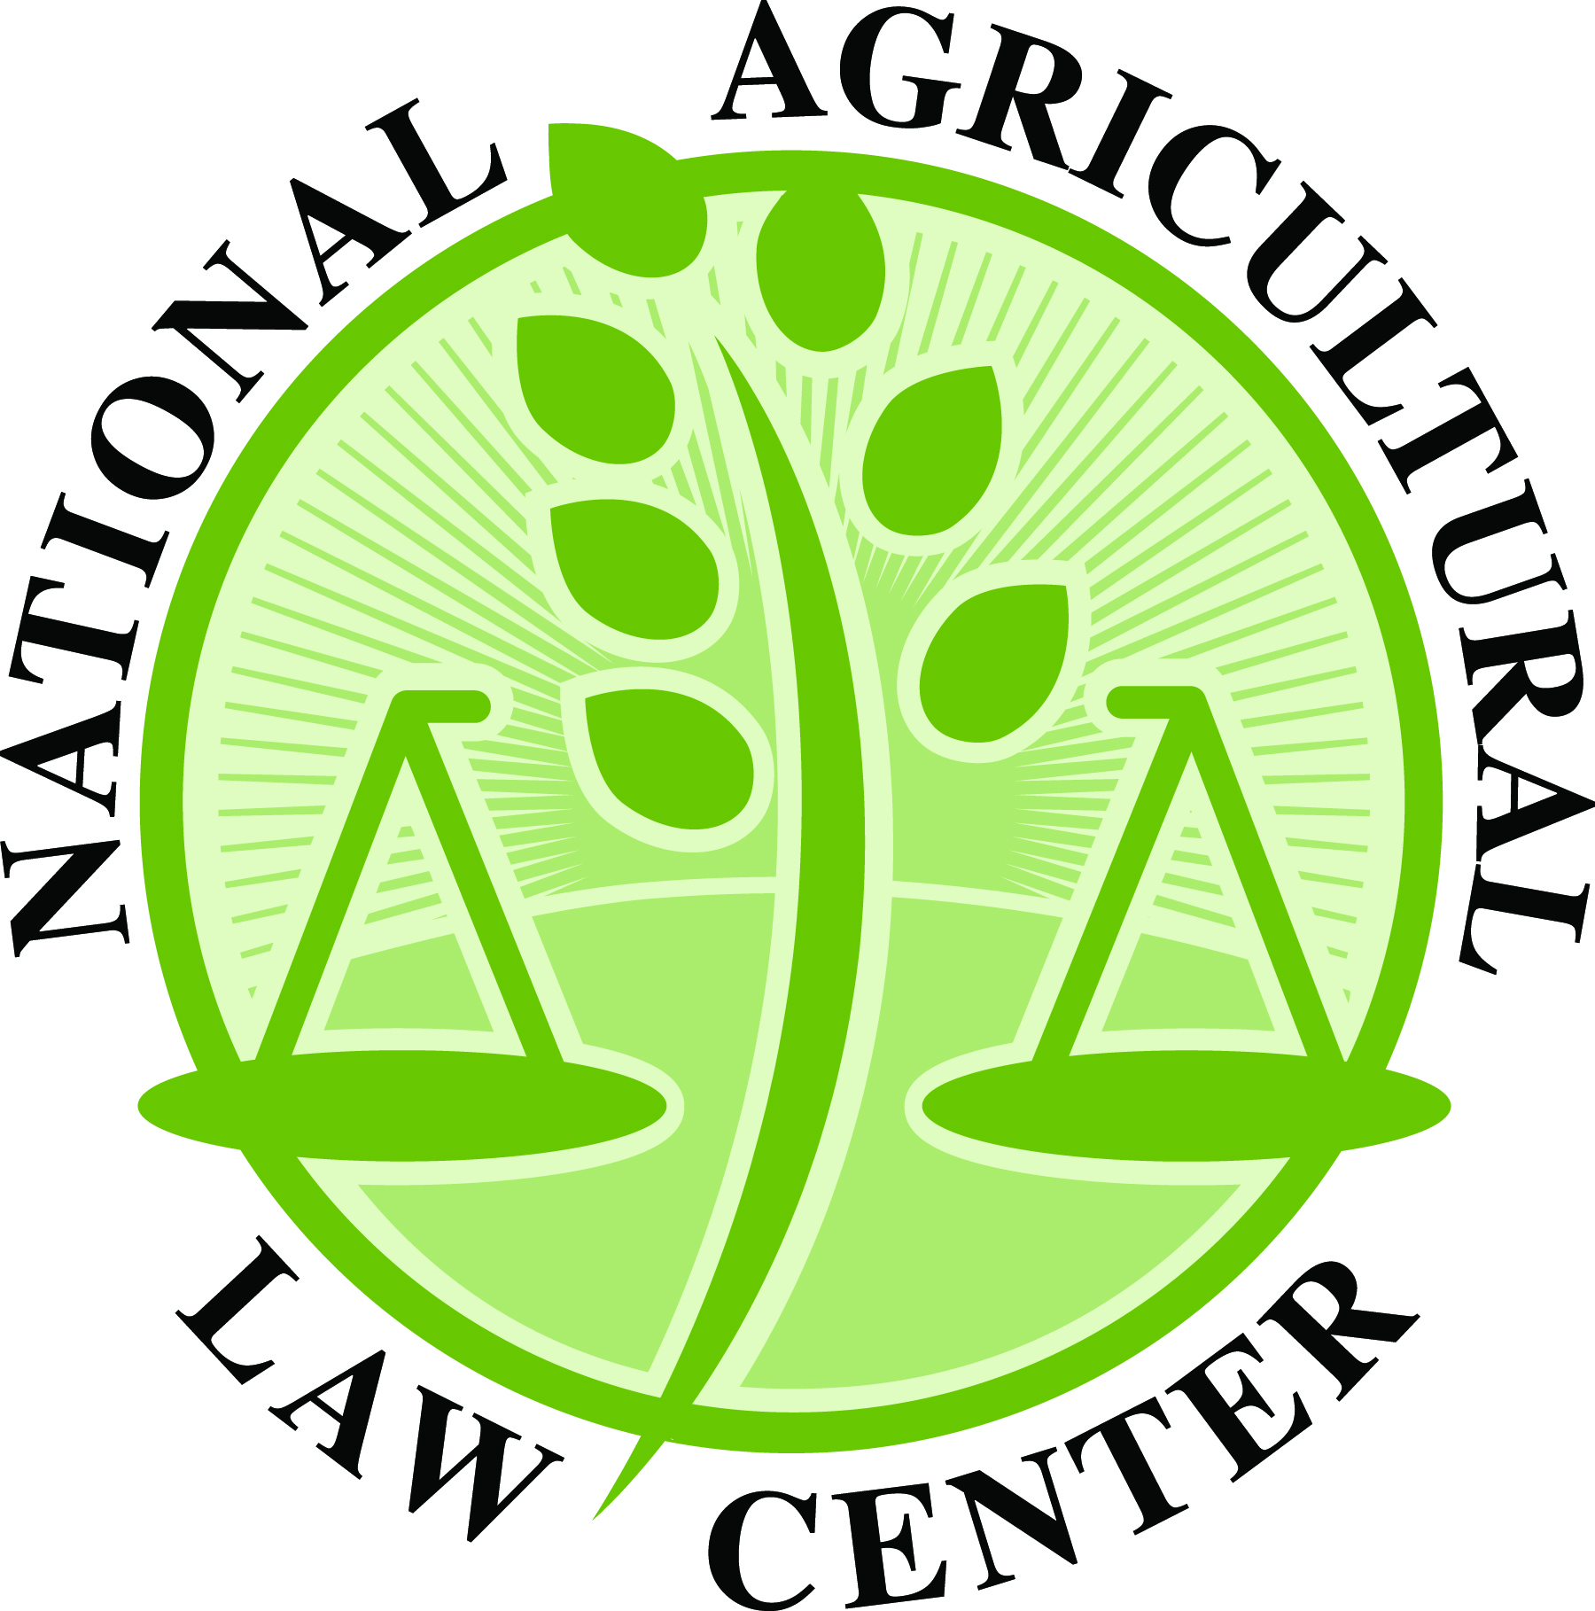
Thanks to Our Partners
The Center for Agricultural and Shale Law is a partner of the National Agricultural Law Center (NALC) at the University of Arkansas System Division of Agriculture, which serves as the nation’s leading source of agricultural and food law research and information. This material is provided as part of that partnership and is based upon work supported by the National Agricultural Library, Agricultural Research Service, U.S. Department of Agriculture.

Slide 9
Today’s Agenda:
Round-up of the past quarter’s legal and regulatory developments impacting the dairy industry
Presenter: Chloe Marie, Research Specialist
Focused topic of interest to dairy producers and professionals:
Topic: International Dairy Trade: Canada - U.S. USMCA Arbitration Round 2
Presenter: Brook Duer, Staff Attorney

Slide 10
Round Up – 1st Quarter 2023
The U.S. Department of Agriculture (USDA) Published Proposed Rule for Child Nutrition Programs, Containing New Added Sugars Standards for Dairy Products
The U.S. Department of Agriculture (USDA) Announced Second Round of Pandemic Market Volatility Assistance Program and Launched New Organic Dairy Marketing Assistance Program
The U.S. Food and Drug Administration (FDA) Published Draft Guidance on Labeling Plant-Based Milk Products
The U.S. Court of Appeals for the Fourth Circuit Held ”Gruyere” Generic, Not Eligible for Trademark Registration

Slide 11
USDA Proposes Added Sugars Limits for School Meal Programs
On February 7, 2023, the USDA Food and Nutrition Service (FNS) published in the Federal Register a proposed rule, titled Child Nutrition Programs: Revisions to Meal Patterns Consistent with the 2020 Dietary Guidelines for Americans.
Comment period closed on April 10, 2023
Proposed limits for dairy products:
Yogurt must not contain more than 6 grams of added sugars per dry ounce;
Flavored milk must not contain more than 10 grams of added sugars per 8 fluid ounces or no more than 15 grams of added sugars per 12 fluid ounces for flavored milk sold as a competitive food for middle and high schools.
Two alternatives for milk options:
Alternative A – would limit flavored milk to high school students only while elementary and middle schools would have various unflavored milk choices;
Alternative B – would allow schools to provide fat-free and low-fat milk, both flavored and unflavored.
Flavored milk, in both alternatives, would be subject to added sugars limits.
USDA intends to publish a final rule before the start of the 2024-2025 school years.
More information is available on docket number FNS-2022-0043.

Slide 12
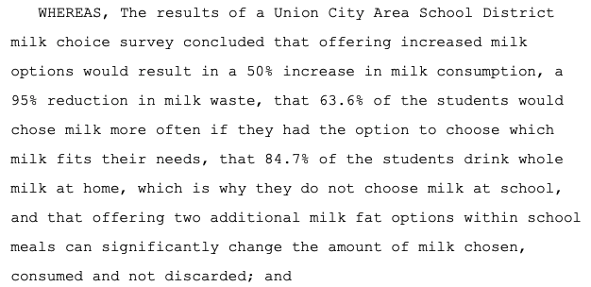
PA Senate Passed Resolution for Whole Milk in State Schools
On March 6, 2023, the Pennsylvania Senate passed Resolution No. 48, urging the U.S. Department of Agriculture (USDA) to add 2% and whole milk to the National School Lunch and Breakfast Programs.

Slide 13
USDA Announced Second Pandemic Market Volatility Assistance Round and Organic Dairy Marketing Aid
On January 23, 2023, USDA announced a second round of Pandemic Volatility Assistance Program (PMVAP) payments for dairy farmers and launched a new Organic Dairy Marketing Assistance Program (ODMAP).
Pandemic Volatility Assistance Program
Over $250 million was already distributed to more than 25,000 eligible dairy farmers with production up to 5 million pounds.
Payments will be available to dairy producers with fluid milk sales from 5 million to 9 million pounds between July and December 2020.
Organic Dairy Marketing Assistance Program
The program will provide $100 million in funding assistance to support smaller organic dairy farms (1st 5M lbs).
The program will help eligible organic dairy producers with up to 75% of their future projected marketing costs in 2023, based on national estimates of marketing costs.
Forthcoming details about the program will be available at www.farmers.gov following the release of the program’s Notice of Funds Availability.

Slide 14
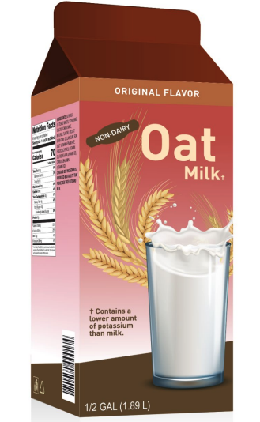
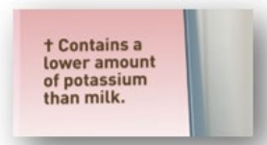
FDA Draft Guidance on Plant-Based Milk Labeling
On February 22, 2023, FDA published Draft Guidance for Industry: Labeling of Plant-Based Milk Alternatives and Voluntary Nutrient Statements. The comment period ends on April 24, 2023.
“While consumers appear to understand that plant-based milk alternatives are distinct products from milk, several consumer studies submitted in response to the notice indicate that consumers, including consumers who purchase plant-based milk alternatives, do not understand the nutritional differences between milk and plant-based milk alternatives. In general, research suggests that many consumers lack an accurate understanding about the specific nutrients in plant-based milk alternatives.”
The FDA recommendations take the form of Q&As (pp. 12 to 26):
The FDA recommends that the term “milk” should be qualified by the plant source of the food and terms such as “plant-based milk” or “dairy free milk” should not be used.
The FDA also recommends that plant-based milk alternatives with different nutrient compositions from dairy milk should have an additional nutrient statement on the product label.

Slide 15
USDA Received Petitions for Reform of Federal Milk Marketing Orders
On March 7, 2023, the National Milk Producers Federation (NMPF) proposed to ”modernize” the Federal Milk Marketing Order (FMMO) system and indicated they would petition the USDA to adopt the proposed changes to Federal Milk Marketing Orders.
NMPF’s Position and Key Points on Changes to the FMMO system
On March 28, 2023, the Wisconsin Cheese Makers Association and International Dairy Foods Association separately petitioned the USDA to amend all-make allowances in the Federal Milk Marketing Order Program.
Re: Petition of the Wisconsin Cheese Makers Association (“WCMA”) for a Hearing to Amend Federal Milk Marketing Orders
Re: Petition of the International Dairy Foods Association (“IDFA”) for a Hearing to Amend Federal Milk Marketing Orders
NMPF and nine other dairy and agricultural associations opposed both petitions, calling for a balanced, measured approach that modernizes the program by addressing other “outdated” pricing factors.

Slide 16
Fourth Circuit Court Ruled ”Gruyere” is a Generic Term
Sep. 17, 2015 – Swiss-registered Interprofession du Gruyère and French-registered Syndicat Interprofessional du Gruyère applied with the U.S. Patent and Trademark Office (USPTO) to register the name “gruyere” as a certification mark in the United States.
A certification mark is a type of trademark that serves to certify a product meets specific standards based on its geographical origin, quality, mode of manufacture, etc., i.e., a “gruyere” certification mark would certify the cheese originates from the Gruyère region of Switzerland and France and would restrict the use of the “gruyere” label to cheese exclusively produced within that region.
Aug. 5, 2020 – the USPTO Trademark Trials and Appeals Board (TTAB) denied registration of the name “gruyere,” finding that the term “gruyere” had become generic in the U.S. and is therefore ineligible for trademark registration.
A generic term is a common name referring to the nature or class of a product and must be understood as such by the public.
Oct. 6, 2020 – Both European consortiums filed a complaint before the U.S. District Court for the Eastern District of Virginia, No. 1:20-cv-1174.
Dec. 15, 2021 – the U.S. District Court upheld the Board’s administrative decision.
Mar. 3, 2023 – the Fourth Circuit Court unanimously affirmed the district court’s decision, “the Consortiums cannot overcome what the record makes clear: cheese consumers in the United States understand ‘gruyere’ to refer to a type of cheese, which renders the term generic.”

Slide 17
Focus Topic: International Dairy Trade: Canada - U.S. USMCA Arbitration Round 2
1st Quarter – 2023
April 18, 2023

Slide 18
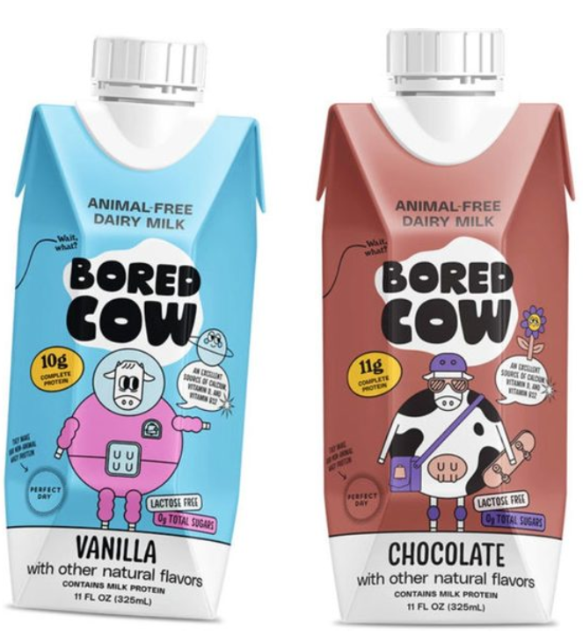
“ANIMAL-FREE DAIRY MILK” ?????
Food Navigator-USA.com
Webinar22-FNU-Dairy Trends
From a wave of ultra-low sugar yogurts and zero sugar dairy milk to a new generation of animal-free cheese, ice cream and creamers made with ‘real’ dairy proteins (minus the cows), we explore what’s trending in the dairy aisle.

Slide 19
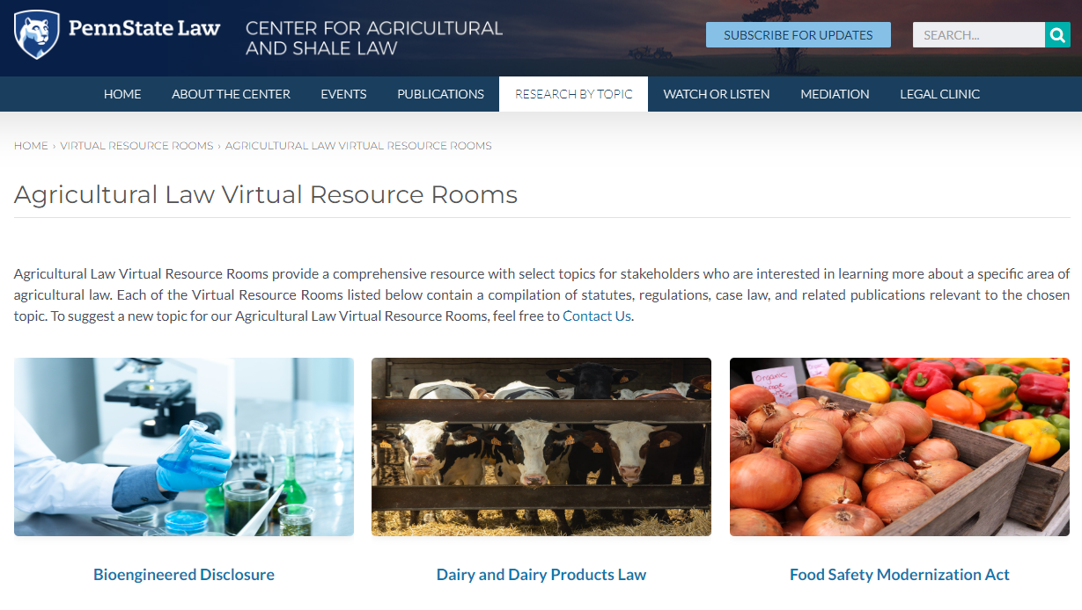
aglaw.psu.edu/research-by-topic/library-guides/ag-law-resource-rooms/

Slide 20
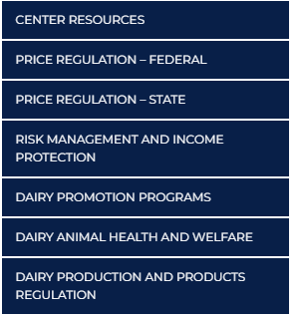
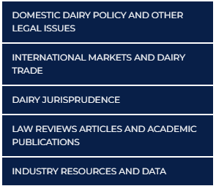
← International Markets and Dairy Trade
$$●$$

Slide 21
Renewal of Trade Promotion Authority (TPA)?
Congressional Research Service (CRS): Trade Promotion Authority Update (12/6/22)
US Constitution:
Article I, Section 8 - Powers of Congress: “To regulate Commerce with Foreign Nations . . .”
Article II, Section 2 – Power of the President: “He shall have Power, by and with the Advice and Consent of the Senate, to make Treaties, provided two thirds of the Senators present concur . . .”
Recent past trade deals have been negotiated and executed using “Trade Promotion Authority” (TPA): Statutory authority allowing the President, acting through the US Trade Representative (USSTR), negotiates the terms and brings it back to Congress for passage by a majority vote. Approval on a strict timeline to assure trading partners that it will be done.
Expired in July 2021. Last authorization enacted in 2015 (TPA-2015, P.L. 114-26)
USMCA was the last trade agreement using TPA. TPA has not been renewed by Congress.

Slide 22
TPA Renewal Raised by March 2023 Letter
3/16/23 Letter to Congress from over 50 ag trade orgs requesting TPA renewal. The letter claimed:
“US Department of Agriculture (USDA) forecasts that the United States will run a food and agriculture trade deficit of $14.5 billion in 2023.”
“Between 2010 and 2020, China and the European Union enjoyed over twice as much advantage from trade agreement tariff reductions as the US . . . In this decade, our situation to date is far worse. The US has not implemented a comprehensive trade agreement that opens new markets in over a decade. Meanwhile, just over a year ago, China added the Regional Comprehensive Economic Partnership to its portfolio of trade agreements and displaced the US as the European Union’s largest trading partner.”

Slide 23
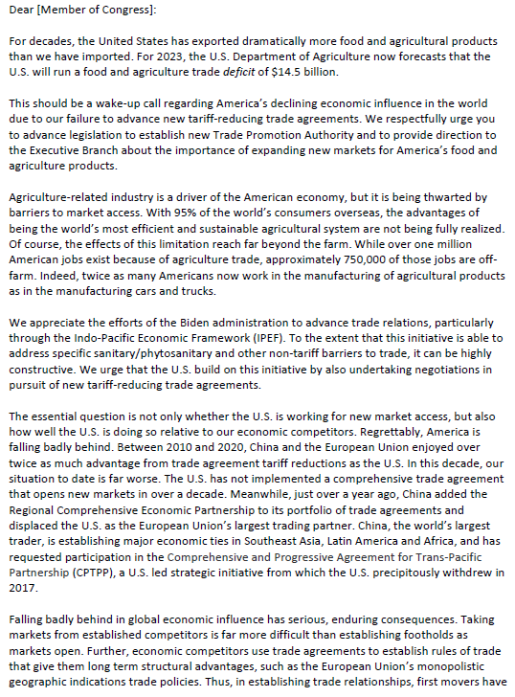
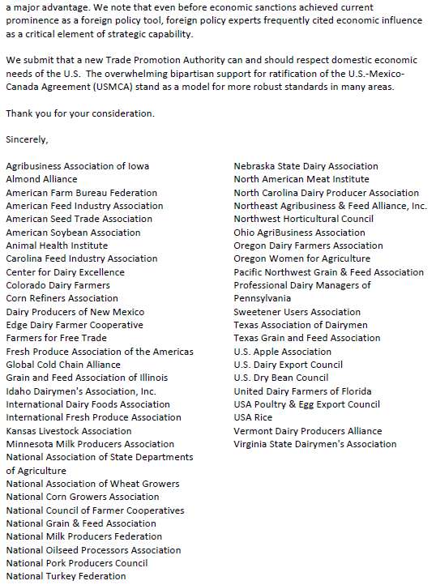

Slide 24
USMCA (effective 7/1/20) United States Mexico Canada Agreement - replaces 1994’s North American Free Trade Agreement (NAFTA)
Negotiations 8/16/7 – 9/30/18. Signed 11/30/18. U.S. Congress approved pursuant to TPA, enacted 1/29/20.
Establishes so–called “tariff – free” trade between the 3 nations. Subject to WTO jurisdiction because the parties are member nations. WTO includes dispute resolution processes.
Sunset Provisions: 6-year review and consent to continue; if one party fails to consent to extend for a new 16-year term, it reverts to 16 annual reviews for consent to continue.

Slide 25
USMCA Resources
Dairy Provisions in USMCA (Dec. 16, 2019).
Enforcing International Trade Obligations in USMCA: The State-State Dispute Settlement Mechanism (Jan. 3, 2020)
USMCA: Implementation and Considerations for Congress (1/30/20)
The United States-Mexico-Canada Agreement (USMCA) (Dec. 28, 2021)
U.S.-Mexico-Canada (USMCA) Trade Agreement (last updated 1/11/23) 2021)

Slide 26
WTO – World Trade Organization Established on January 1, 1995. Replaced “General Agreement on Tariffs and Trade” (GATT) from 1947
Multi-lateral Treaty - 123 nations at the outset, now 159.
Many separate “agreements” within it.
“Dispute Settlement Body” – a nation files a dispute alleging another nation has violated one of the agreements; a “quasi-judicial” process (trial-like) decides the merits and issues a decision.
However, WTO dispute resolution process is presently “broken” by so-called “panel blocking.”
Due to U.S. refusal to appoint Appellate Body Judges, the WTO dispute resolution system no longer functions.

Slide 27
USMCA’s Internal Dispute Resolution Process
USMCA Chap. 31:
Domestic trade-affecting measure inconsistent with USMCA obligations or failed to carry out an obligation.
Interpretation or applicability of a USMCA provision.
A party has “nullified or impaired” a benefit reasonably expected to accrue.
Process:
Request confidential consultations
Establish a panel (effective upon request). Similar to AAA arbitration.
Report due 150 days after appt. of final panelist.
If a violation found, parties seek resolution w/in 45 days.
If no resolution, complaining party may “suspend benefits” to other party.
Once invoked = exclusive mechanism for that particular dispute.

Slide 28
USMCA Arbitration – Round 1
12/9/20 – U.S. requested consultations.
12/21/20 – Consultations held.
5/25/21 – Panel requested & established.
5/31/21 – 7/5/21 - panel agreed upon.
7/12/21 – U.S. Initial Written Submission.
8/20/21 – Canada Initial Written Submission.
10/25-26/21 – Oral Hearing; 10/27/21 - Panel deliberations.
11/24/21 – Draft of Initial Report.
12/9/21 – Parties Comments on Initial Report.
12/20/21 – Final Report issued.

Slide 29
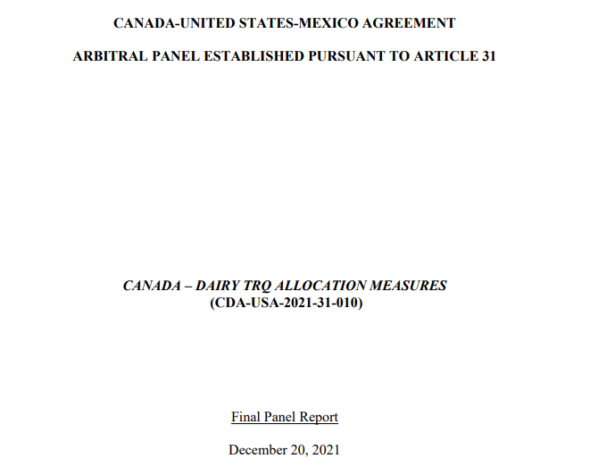
Link to the Final Report

Slide 30
Panel Finds Canada in Violation of USMCA
On January 4, 2022, U.S. Trade Representative Katherine Tai announced that a dispute settlement panel, convened under the United States-Mexico-Canada Agreement (USMCA), found that Canada’s practice of reserving most of the country’s dairy tariff-rate quotas (TRQs) to Canadian processors was in violation of the USMCA.
In accordance with the USMCA, Canada maintains fourteen dairy TRQs, which allow for reduced import tariffs on those products. According to the panel’s final report, since 1995, Canada has reserved access to 85–100% of those dairy TRQs exclusively for Canadian dairy processors—a supply side party in Canada’s dairy market—disallowing equal TRQ access to retailers—a demand side party.
The panel found that Canada’s practice of reserving TRQs for processors was in violation of USMCA Article 3.A.2.11(b) in failing to “ensure that” the country’s practice “does not . . . limit access to an allocation to processors.” For background, see ALWR—May 28, 2021, “U.S. Initiates Formal USMCA Trade Dispute with Canada Over Tarif-Rate Quotas.”

Slide 31
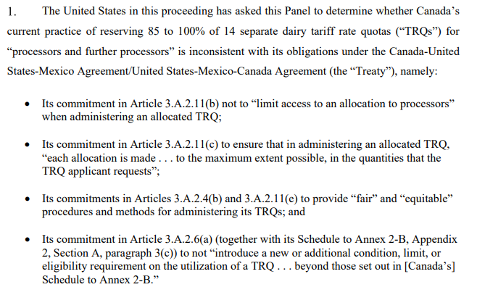

Slide 32
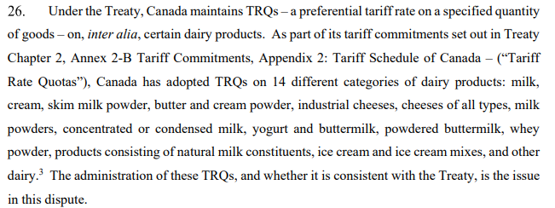

Slide 33
The gist of the decision

Slide 34
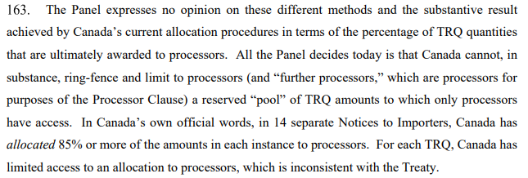
The set up for Round 2

Slide 35
Canada’s annual TRQ application period

Slide 36
3/1/22 Canada proposes TRQ change

Slide 37
U.S. Rejects Canada’s Attempted “Fix”
On May 5, 2022, U.S. Trade Representative Katherine Tai met with Canadian Minister of Trade Mary Ng in Ottawa and thereafter publicly announced, amongst other things, the “importance of Canada fully meeting its USMCA commitments, including its allocation of dairy tariff-rate quotas.” This was the first meeting of the top trade officials from each country since the January 4, 2022, disclosure of the December 20, 2021 USMCA Arbitration Panel Final Report concluding, in response to U.S. allegations, that Canada breached Article 3.A.2.11(b) of the United States-Mexico-Canada Agreement (USMCA) by reserving dairy tariff-rate quotas exclusively for the use of Canadian dairy processors.
This was also the first public statement by Tai that Canada’s first attempt to satisfy U.S. demands to cure the breach, a March 1, 2022 proposal of revised TRQs allocation and policy changes, had been formally rejected. Over the past month, Congressional representatives and the National Milk Producers Federation and U.S. Dairy Export Council have urged a public rejection. According to media accounts, on May 14, 2022, after meeting with Canadian Agriculture Minister Marie-Claude Bibeau earlier that day, USDA Secretary Vilsack confirmed that a second Canadian proposal has also been rejected and again failed to include an allocation of TRQs to retailers. Further details have not been made public. On May 12, 2022, New Zealand filed an identical request for consultation alleging Canada has breached the Trans-Pacific Partnership (TPP) trade agreement by limiting its TRQs to processers’ use.

Slide 38
Canada Proceeds w/o U.S. Concurrence
(5/16/22)

Slide 39
U.S.’s New 2022 Consultation Requests
On December 20, 2022, the U.S. Trade Representative (USTR) announced an expanded request for new dispute resolution consultations with Canada under the United States-Mexico-Canada Agreement (USMCA) to address Canada’s administration of its dairy tariff rate quotas (TRQs).
This new request broadens a previous consultation request, announced on May 25, 2022, to address claims that Canada violates the USMCA by favoring dairy processors over other potential importers in its market-share allocation of TRQs among entities eligible for the reduced tariff rates on imported U.S. dairy products.
In 2021, the United States first challenged Canada’s administration of its dairy TRQs by restricting eligible entities to processors. In that initial dispute resolution proceeding, a USMCA arbitration panel, in January 2022, determined that Canada’s restriction of eligibility to processors violated Article 3.A.2.11(b) of the USMCA. Following this finding, Canada implemented one change by adding distributors as eligible parties, but not retailers or other potential importers. This change in eligible importing parties has remained unsatisfactory to the United States and spurred the May 2022 request. The latest request includes the same grounds as the May 2022 request but also includes the market-share allocation challenge. For background, see ALWR—May 6, 2022, “U.S. Twice Rejects Canada’s USMCA Dairy Tariff-Rate Quota Proposals.”

Slide 40
USMCA Arbitration – Round 2 Commenced
On January 31, 2023, the Office of the U.S. Trade Representative (USTR) announced that the U.S. has requested—for the second time—that an arbitration panel adjudicate the U.S.’s claim that Canada’s administration of its dairy tariff-rate quotas (TRQ) violate the United States-Mexico-Canada Agreement (USMCA).
A January 2022 arbitration panel decision found Canada’s TRQ eligibility criteria were a USMCA violation. According to the U.S., Canada’s resulting minimal change to TRQ eligibility does not remedy the underlying violation.
The new arbitration request reasserts TRQ eligibility and adds TRQ allocation as Canadian USMCA violations.
The USTR also published a collection of quotations from U.S. Congress members and dairy industry stakeholders supporting USTR’s arbitration request.

Slide 41
Arbitration Round 2 Issues

Slide 42
New Zealand Requests Canadian TRQ Arbitration
On November 7, 2022, New Zealand’s Ministry of Foreign Affairs and Trade submitted formal notification to Canada requesting the establishment of a panel to hear New Zealand’s challenge to Canada’s practice of reserving its dairy tariff rate quotas (TRQs) for Canadian dairy processors, which New Zealand claims violates the Comprehensive and Progressive Agreement for TransPacific Partnership (CPTPP).
Previously, on May 12, 2022, New Zealand announced that it had requested formal consultations with Canada, which the countries held in June 2022, but which New Zealand states, “did not resolve matters.”
Also announced by the New Zealand government, New Zealand’s panel request notice described the trade effects of Canada’s dairy TRQ allocation practices, stating that they “encourage chronic underfill of [Canada’s] dairy TRQs, reduce their commercial value for exporting CPTPP Parties, and undermine the market access negotiated under CPTPP.”
The United States is also in dispute with Canada over its dairy TRQ practices as violative of the United States-Mexico-Canada Agreement (USMCA), which remains unresolved. See “U.S. Twice Rejects Canada’s USMCA Dairy Tariff-Rate Quota Proposals,” ALWR—May 6, 2022.

Slide 43
THANK YOU! PLEASE SUBMIT QUESTIONS!
Brook Duer
Staff Attorney
Center for Agricultural and Shale Law
Penn State Law
329 Innovation Boulevard, Suite 118
University Park, PA 16802
(814) 863-3396
dhd5103@psu.edu
18 years in private practice in Lancaster County
12 years at the Pennsylvania Department of Agriculture (8 years as Chief Counsel)
Penn State Ag Law Center since 2019.

Slide 44
