Slide 1
Understanding Agricultural Law
Educational Series
Understanding the Basics of
Agricultural Cooperatives
August 26, 2022

Slide 2
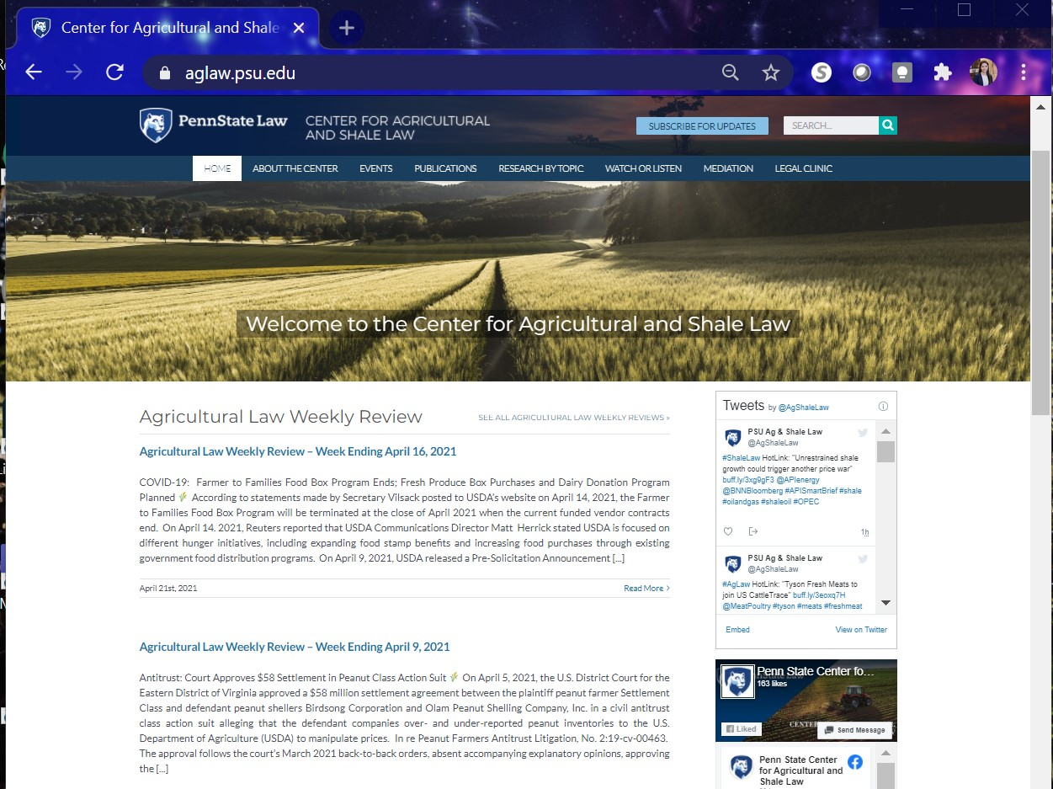
Center for Agricultural and Shale Law
https://aglaw.psu.edu
Agricultural Law Weekly Review
Shale Law Weekly Review
Agricultural Law Virtual Resource Rooms
Shale Law Virtual Resource Rooms
Agricultural Law Issue Tracker
Shale Law Issue Tracker
Agricultural Law Podcast
Social Media
  Twitter, Facebook, LinkedIn, YouTube
Presentations
PA Ag Mediation Program

Slide 3
Our Website

Slide 4
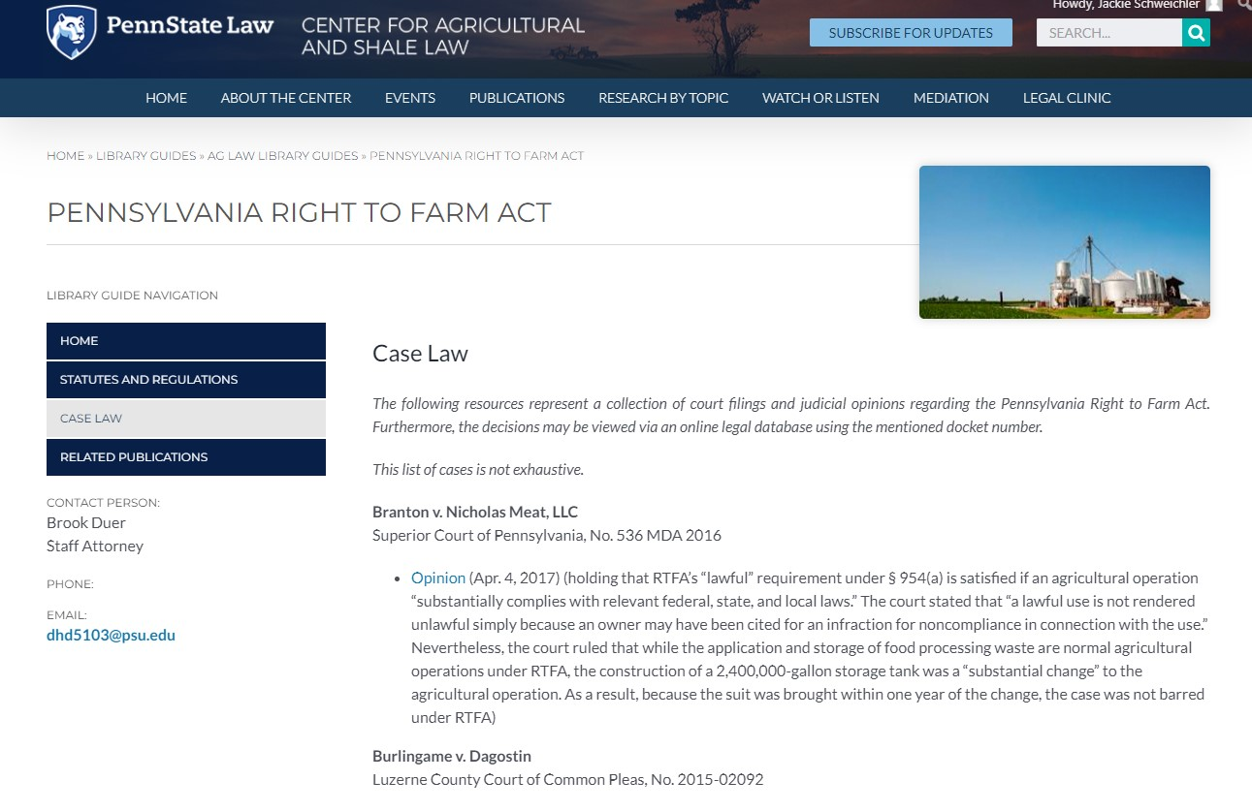

Slide 5
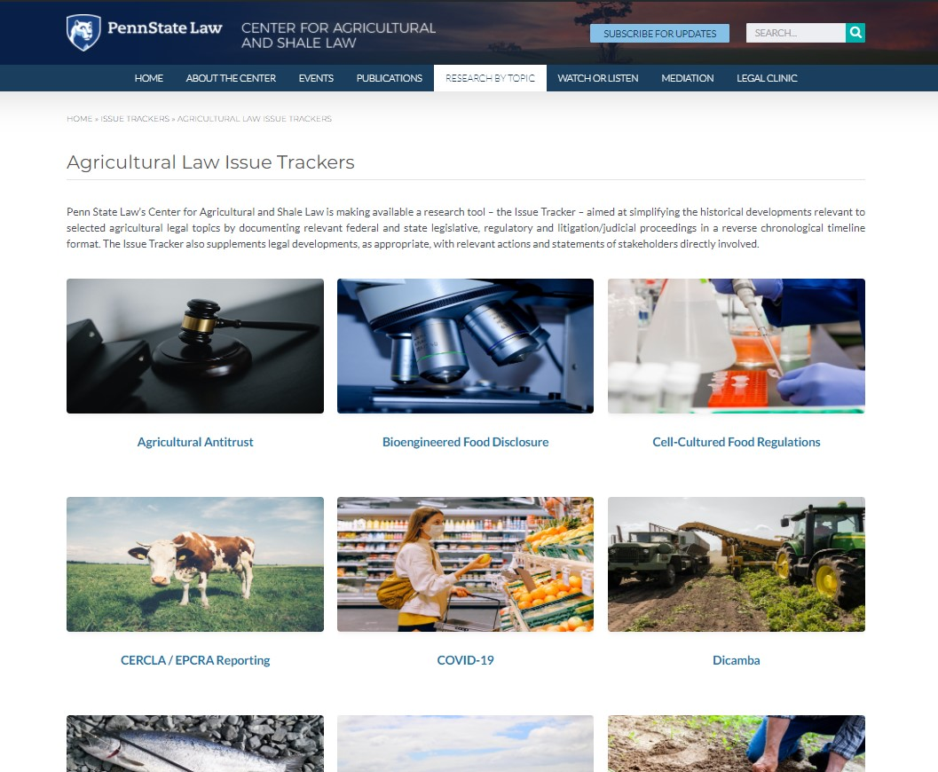

Slide 6
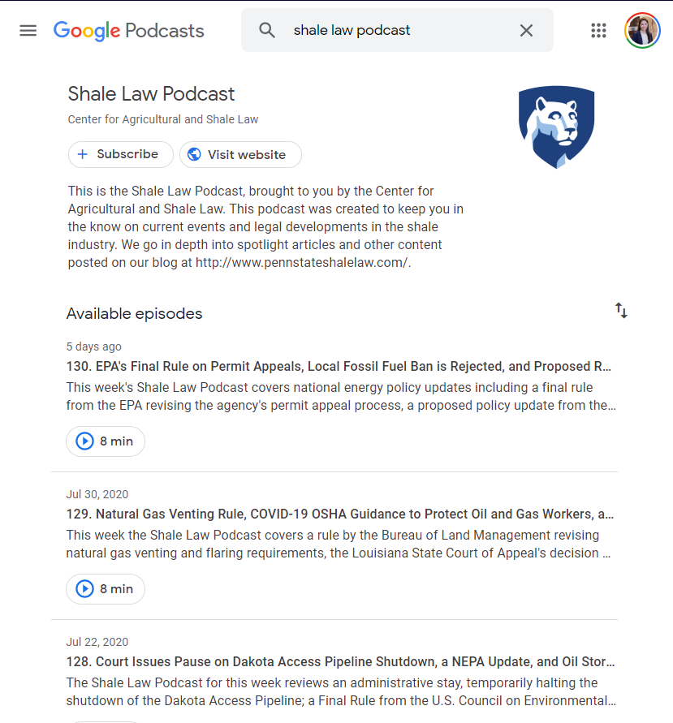
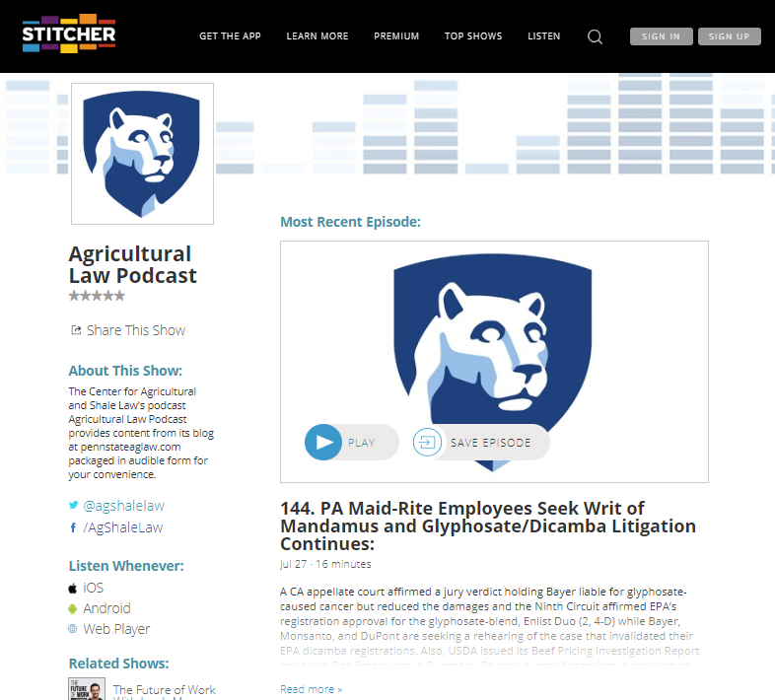
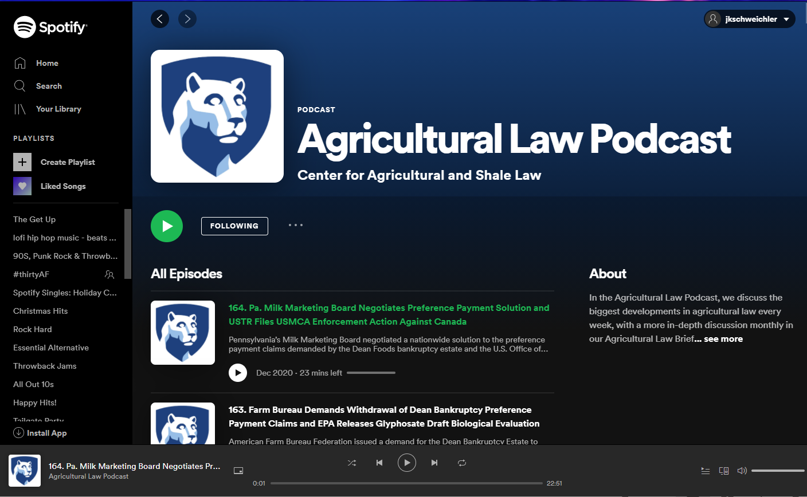
Our Podcasts are also Available on:
Apple Podcasts
Spotify
Google Podcasts
Stitcher
Notes:
I do not have access to iTunes – but I should be able to get a screenshot soon

Slide 7
Pennsylvania Agricultural
Mediation Program
Contact us:
  Jackie Schweichler, Program Coordinator
  329 Innovation Blvd.
  University Park, PA 16802
  (814) 746-4619
  AgMediation@PennStateLaw.psu.edu
  Website: www.PAAgMediation.com

Slide 8
Understanding Agricultural Law
A Legal Educational Series for General Practice Attorneys and Business Advisors Representing Agricultural and Rural Clients
This webinar series is specifically tailored to create subject matter literacy and competence on fundamental issues of agricultural law for attorneys, advisors, and service providers to agricultural producers and agri-businesses.

Slide 9
Pennsylvania Department of Agriculture
Agricultural Business Development Center

Slide 10
Understanding Agricultural Law Webinar Series: Past Topics
Understanding the Basics of
Agricultural Labor Laws (April 29, 2022)
Leasing Farmland for Energy Development (May 20, 2022)
Local Land Use Regulation of Agriculture (June 24, 2022)
Statutory Protections for Agricultural Operations (July 22, 2022)

Slide 11
Understanding Agricultural Law Webinar Series: Upcoming Topics
Friday, September 23, 2022, noon–1:00 ET
Understanding the Basics of Livestock Market Regulation
Friday, October 21, 2022, noon–1:00 ET
Understanding the Basics of Crop Insurance

Slide 12
Additional Upcoming Webinars from the Center for Agricultural and Shale Law:
Quarterly Dairy Legal Update Series
Tues., Oct. 25, 2022, noon ET:
  2023 Farm Bill & Dairy
Legal Planning for Specialty Crop Producers Series
Wed. Nov. 16, 2022, noon ET:
  Licensing and Regulatory Obligations in Selling Raw and Processed Specialty Crop Products.
Wed. Nov. 30, 2022, noon ET:
  Municipal Law & Zoning for Agritourism/ Agritainment, Specialty Crop Processing & Sales.
Wed. Dec. 14, 2022, noon ET:
  Statutory Protections/Restrictions: Understanding PA’s Ag Area Security, Right-To-Farm, ACRE, and Clean & Green Laws.

Slide 13
Understanding Agricultural Law
This webinar will be recorded.
Use the Q&A feature for questions.
CLE credits:
  Link will be posted in the chat
  Please fill out form
  Listen for code word
  Questions?
    Email: aet17@psu.edu

Slide 14
Understanding the Basics of Agricultural Cooperatives
August 26, 2022
Presenter: Ross Pifer,
Center for Agricultural and Shale Law
Doing business through cooperatives has been part of U.S. agriculture and life in rural America since the 19th century. Any professional involved with agriculture in any capacity needs to understand the singularly unique business features of a cooperative, its governance and operational structure, revenue distribution and tax treatment under law. Lastly, agricultural cooperatives have a carefully crafted legal relationship to antitrust laws forged in the early 20th century that remains just as relevant a century later. This CLE offers the essential information to understand how cooperatives operate and why they are distinct from all other business forms.

Slide 15
Overview of Today’s Presentation
Agricultural Cooperatives Generally
Major Federal Statutes and Case Law
  Capper Volstead Act
  Ag Fair Practices Act
Current Issues

Slide 16
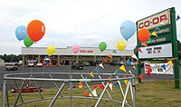
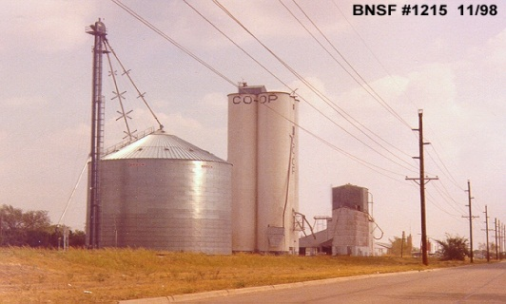



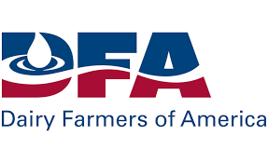



What is a Cooperative?

Slide 17
Forms of Business Organizations
Sole proprietorship
Partnership
Corporation
LLCs, LLPs, Non-profit corporations, Cooperatives

Slide 18
Forms of Business Organizations
Pennsylvania Consolidated Statutes, Title 15
  Chapter 71 – Cooperative Corporation Law of 1988
  Chapter 73 – Electric Cooperative Law of 1990
  Chapter 75 – Cooperative Agricultural Association Law of 1990

Slide 19
Cooperative Principles
Corporate purpose
  Profit for shareholders
Core principle behind operation of cooperative
  Benefits of collective action
    To purchase products
    To sell products
    To provide/receive services

Slide 20
Role of Agricultural Cooperatives
  Approximately 38.6% of farm output marketed through cooperatives
    Milk is approximately 85%
  Approximately 26% of farm inputs are purchased through cooperatives
  Cooperatives also exist in other aspects of agricultural / rural communities
    Credit and finance
    Rural electric and other services

Slide 21
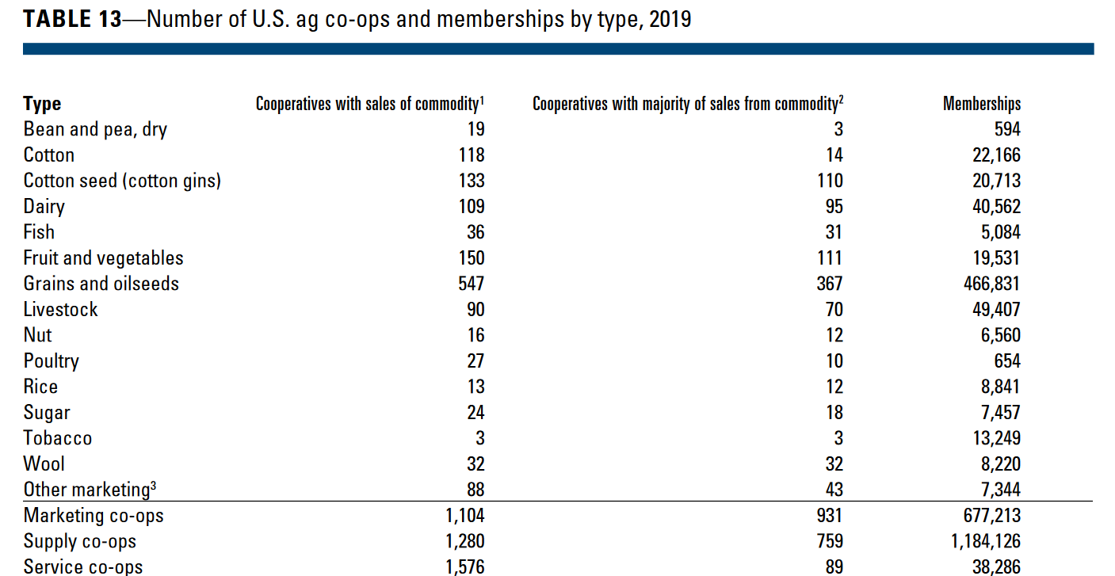
Agricultural Cooperatives
Source – USDA RD

Slide 22
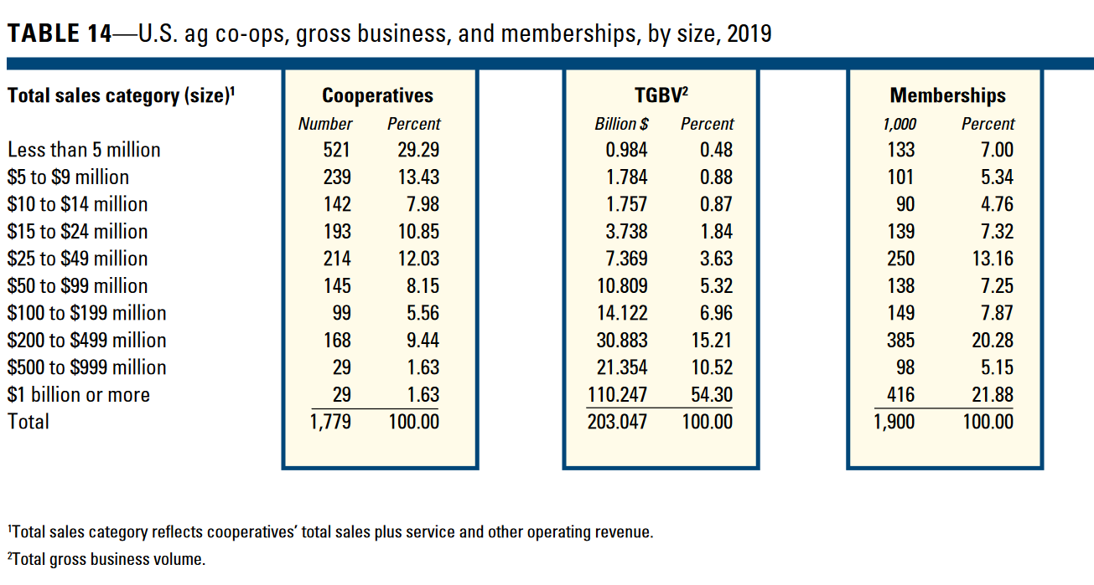
Agricultural Cooperatives
Source – USDA RD

Slide 23

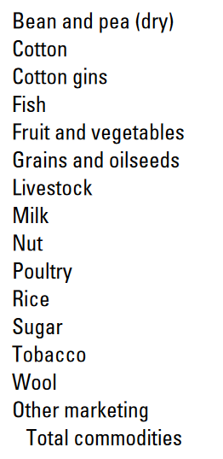
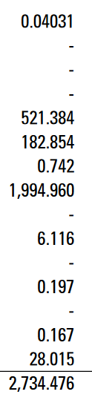

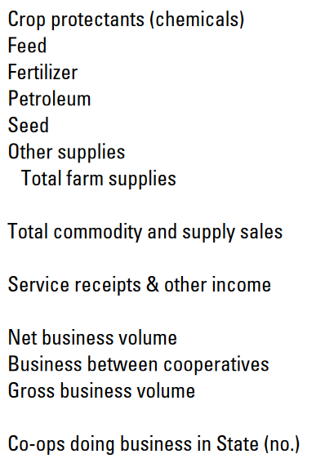
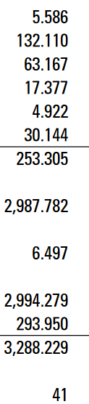
Agricultural Cooperatives
Source – USDA RD

Slide 24
Rochdale Society of Equitable Pioneers - Goals
To sell provisions at the store
To purchase homes for their members
To manufacture good their members needed
To provide employment for members

Slide 25
Rochdale Cooperative Principles
Democratic voting by members
Open membership
Equity provided by members
Limited equity ownership by individual members
Net income distributed to members on a patronage basis
Limited equity dividends

Slide 26
Rochdale Cooperative Principles
Exchange of goods and services at market price
Duty to educate
No credit
No unusual risk assumption
Political and religious neutrality
Equality in membership

Slide 27
Basic Cooperative Principles
User-Owner Principle
  Those who own and finance the cooperative are those who use the cooperative.
User-Control Principle
  Those who control the cooperative are those who use the cooperative.
User-Benefits Principle
  The cooperative’s sole purpose is to provide and distribute benefits to its users on the basis of their use.

Slide 28
Primary Types of Cooperatives
Purchasing cooperative (759 in 2019)
  Economies of scale in purchasing
  Mechanics of patronage refund/dividend
Marketing cooperative (931 in 2019)
  Benefits of collective marketing
  Mechanics of product purchasing
Service cooperative (89 in 2019)

Slide 29
Antitrust Issues
1890 – Sherman Antitrust Act
1914 – Clayton Act
1922 – Capper-Volstead Act
  “Magna Carta of Cooperatives”
  “Cooperative Bill of Rights”

Slide 30
Capper-Volstead Act
7 USC sections 291-292
Provides a limited antitrust exemption to associations of producers
  Essentially permits an association of farmers to act as one farmer
Key questions:
  Who is protected?
  What activities are protected?

Slide 31
Authorization of associations
7 USC section 291
Persons engaged in the production of agricultural products as farmers, planters, ranchmen, dairymen, nut or fruit growers may act together in associations, corporate or otherwise, with or without capital stock, in collectively processing, preparing for market, handling, and marketing in interstate commerce, such products of persons so engaged.

Slide 32
Additional Requirements
All associations must be operated for the mutual benefit of the members.
Associations shall not have more nonmember business than member business.

Slide 33
Additional Requirements
No member is allowed more than one vote because of the amount of stock or membership capital; OR
Association cannot pay dividends in excess of 8% per year.

Slide 34
Restraint of Trade – 7 USC section 292
Association cannot engage in restraint of trade to such an extent that price of any agricultural product is unduly enhanced.

Slide 35
Capper-Volstead Act – Case Law
Case-Swayne v. Sunkist (U.S. 1967)
  Challenge of Sunkist’s cooperative status
    Inclusion of for-profit packing houses
  Ruling that a protected association must be composed solely of agricultural producers
    Even one ineligible member removes entire association from Capper-Volstead protection.
  Raised question of who is or is not considered to be an agricultural producer

Slide 36
Capper-Volstead Act – Case Law
In re: Mushroom Direct Purchaser Antitrust Litigation (E.D. Pa. 2009)
  Parties
    EMMC is a large mushroom cooperative
    Plaintiffs are direct purchasers of mushrooms
  Basis for claim: price for mushrooms has been artificially inflated
  Defense raised: status as a Capper-Volstead cooperative

Slide 37
Capper-Volstead Act – Case Law
In re: Mushroom Direct Purchaser Antitrust Litigation (E.D. Pa. 2009)
  Issue: Does EMMC qualify as a Capper-Volstead cooperative?
  Member M. Cutone is a non-farmer processor.
    Complete identity of ownership between M. Cutone (not a grower) and M&V (a grower)
    M. Cutone was wrongly registered
    Argued that M. Cutone’s membership status was a de minimus violation

Slide 38
Capper-Volstead Act – Case Law
In re: Mushroom Direct Purchaser Antitrust Litigation (E.D. Pa. 2009)
  Ruling:
    Not a de minimus violation
    M. Cutone had power to participate in decision making.
    M. Cutone was the type of entity from whom C-V was trying to protect farmers.

Slide 39
Capper-Volstead Act – Case Law
National Broiler Marketing Assn v. US, 436 U.S. 816 (1978)
  NBMA is non-profit cooperative association
    Approx. 75 members
    Members involved in production and marketing of broiler chickens
  DOJ brought action for violation of Sherman Act.
  Issue: Who is a farmer?

Slide 40
Capper-Volstead Act – Case Law
National Broiler Marketing Assn v. US, 436 U.S. 816 (1978)
  Purpose of CVA was to bolster market strength of farmers
  Congress did not intend to extend benefits to processors and packers.
  Holding: Integrator who owns neither a breeder flock nor a hatchery and that maintains no grow-out facility is not entitled to CVA protection.

Slide 41
Agricultural Fair Practices Act
Background
  In the 1950s and 1960s, some companies were refusing to deal with cooperative members.
  Statute was enacted to prevent retaliation against cooperative members.

Slide 42
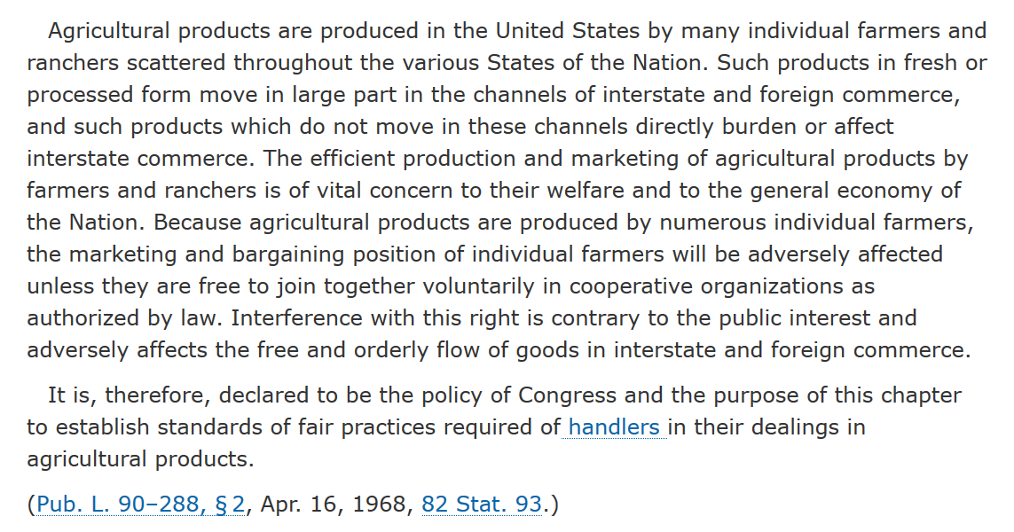
Agricultural Fair Practices Act – section 2

Slide 43
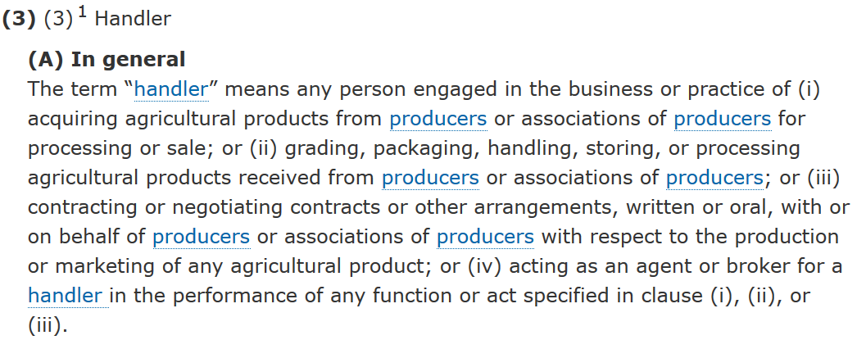
Agricultural Fair Practices Act – section 3

Slide 44
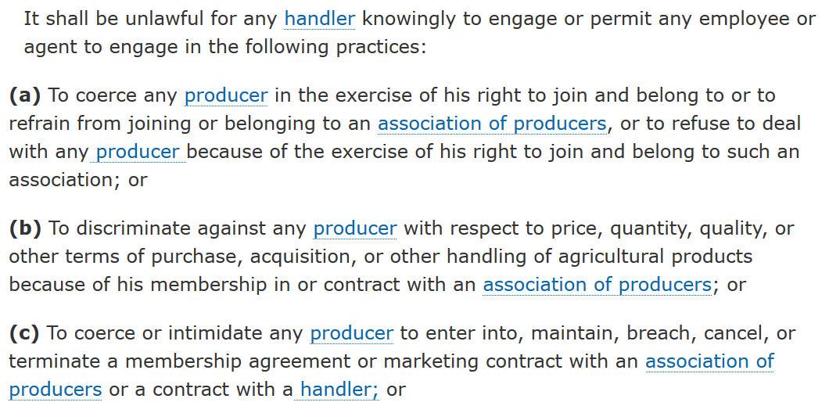
Agricultural Fair Practices Act – section 4

Slide 45
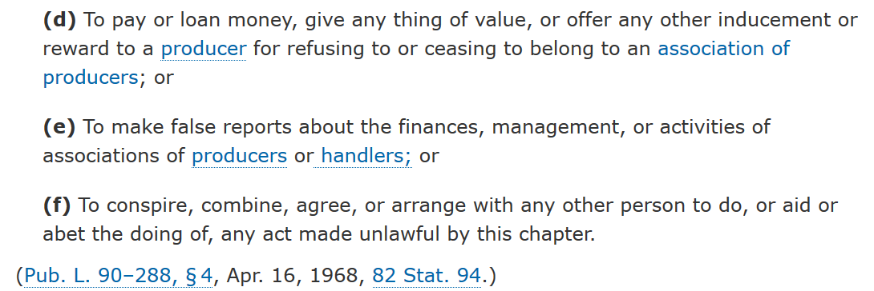
Agricultural Fair Practices Act – section 4

Slide 46
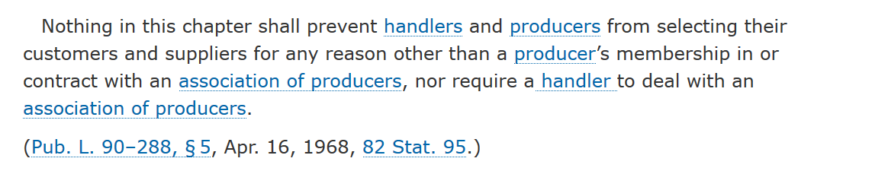
AFPA Disclaimer – section 5

Slide 47
Agricultural Fair Practices Act – Case Law
Butz v. Lawson Milk (N.D. Ohio 1974)
  USDA filed suit against Lawson Milk (handler) for terminating contract with dairy farmer because of farmer’s membership in cooperative.

Slide 48
Agricultural Fair Practices Act – Case Law
Butz v. Lawson Milk, 386 F.Supp. 227 (N.D. Ohio 1974)
  Timeline:
    9/1/58 – Weir signs marketing agreement with Lawson
    6/16/69 – Weir enters into agreement with DCSA
    6/27/69 – Weir letter to Lawson
    7/3/69 – Lawson letter to Weir
    7/2/69 (rcvd after 7/3/69) – DCSA letter to Lawson
    6/2/70 – Weir letter to USDA
    7/29/71 – USDA action against Lawson

Slide 49
Agricultural Fair Practices Act – Case Law
Butz v. Lawson Milk (N.D. Ohio 1974)
  Lawson argument – If they hadn’t terminated contract, they would have been forced to deal with cooperative.
  Court – It was incumbent on Lawson to allow farmer the opportunity to continue to deal with Lawson regardless of cooperative membership.

Slide 50
Agricultural Cooperatives – Current Issues
NCFC 2022 Priorities
Numerous legislative and regulatory issues arise during the course of a year, and NCFC will work to ensure the value of farmer cooperatives is recognized by Congress and the Administration. In 2022, NCFC will focus its efforts on key priority issues for farmer cooperatives, including:
1. Support the Capper-Volstead Act antitrust protections for farmer cooperatives and protect the rights of farmers to join or form cooperatives to market their products and improve their income from the marketplace.
2. Maintain Internal Revenue Code Subchapter T tax provisions for farmer cooperatives and promote favorable tax treatment for farmer cooperatives.
3. Support legislative and regulatory efforts that promote the Farm Credit System’s unwavering mission to provide credit and related services to the agricultural sector and rural America.
4. Maintain and promote farmer cooperative eligibility and access under USDA and other federal programs and initiatives.

Slide 51
Agricultural Cooperatives – Resources
Keystone Development Center – kdc.coop
National Council of Farmer Cooperatives – ncfc.org
USDA Rural Business-Cooperative Service
  Federal Statutes of Special Importance to Agricultural Cooperatives (Revised August 2017)
National Cooperative Bank – ncb.coop
National Agricultural Law Center – Cooperatives Reading Room

Slide 52
THANK YOU!
Center for Agricultural and Shale Law
Penn State Law
329 Innovation Boulevard, Suite 118
University Park, PA 16802

