Slide 1
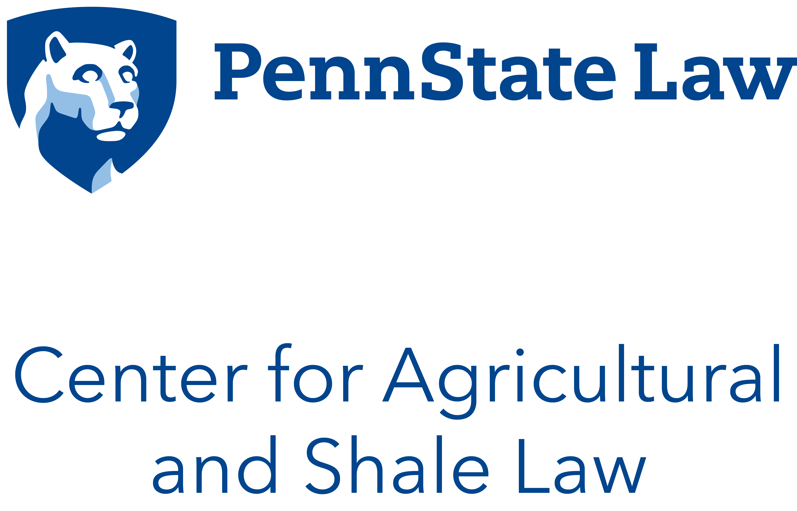

Slide 2

Review of Current
Agricultural Law Topics
      Pennsylvania State Council of Farm Organizations
            December 2, 2021, 11:00 AM EDT

Slide 3
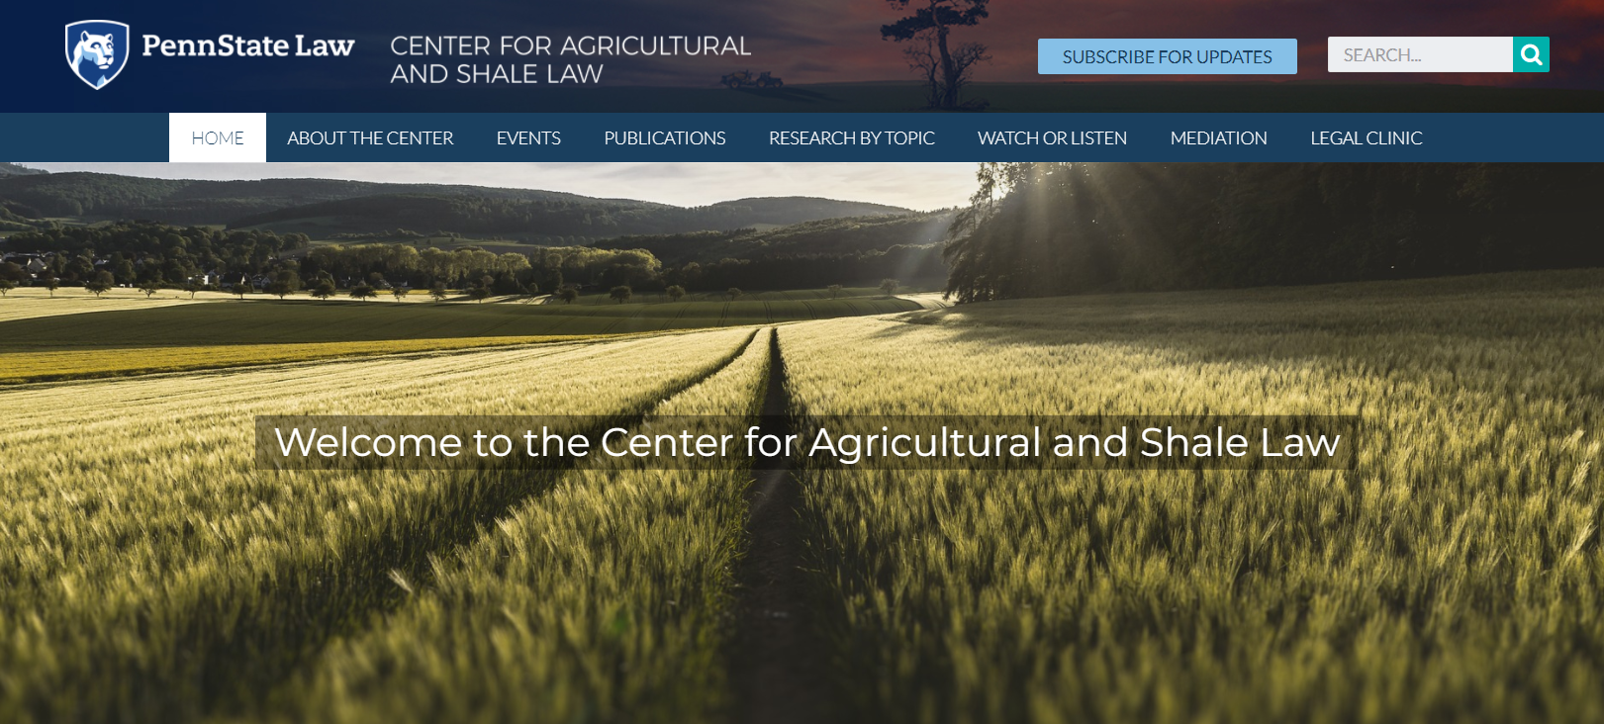
aglaw.psu.edu

Slide 4
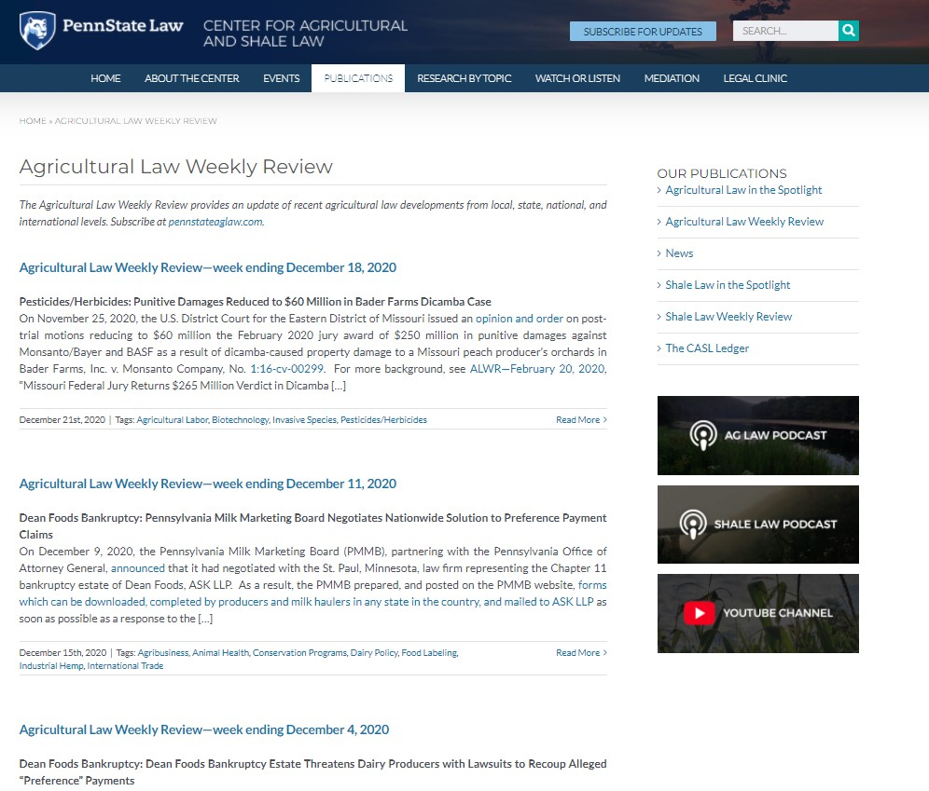

Slide 5
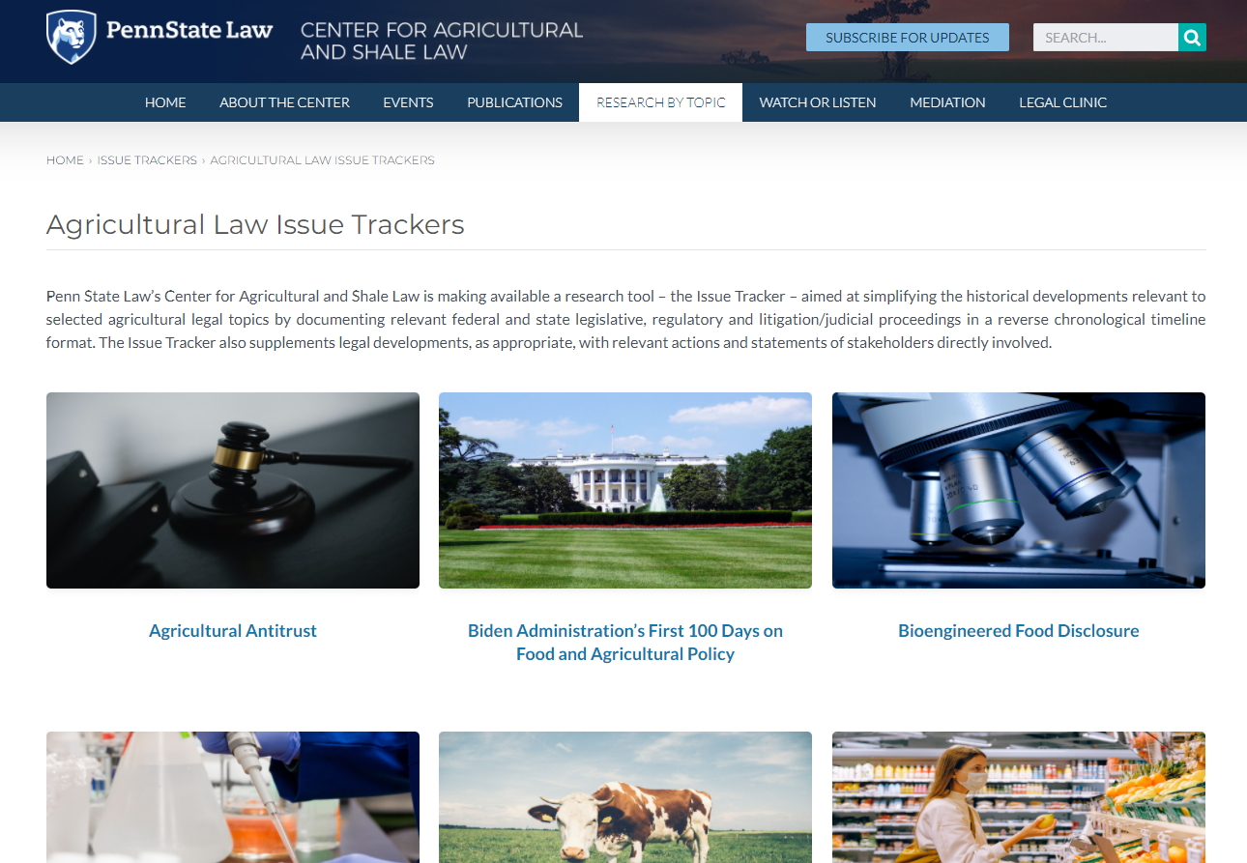

Slide 6
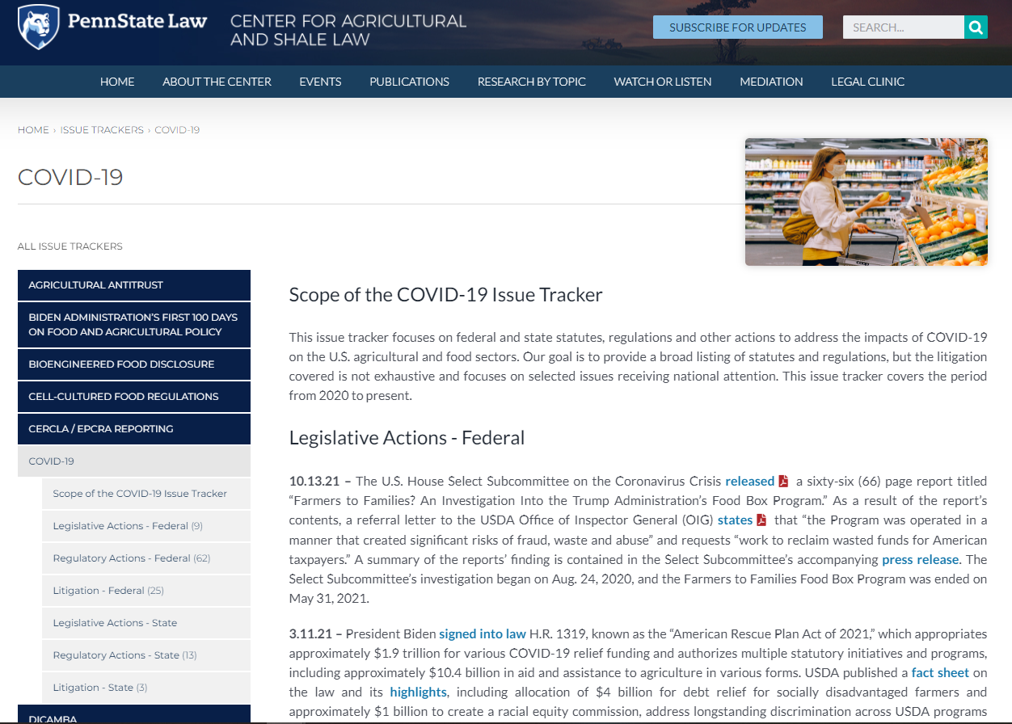

Slide 7

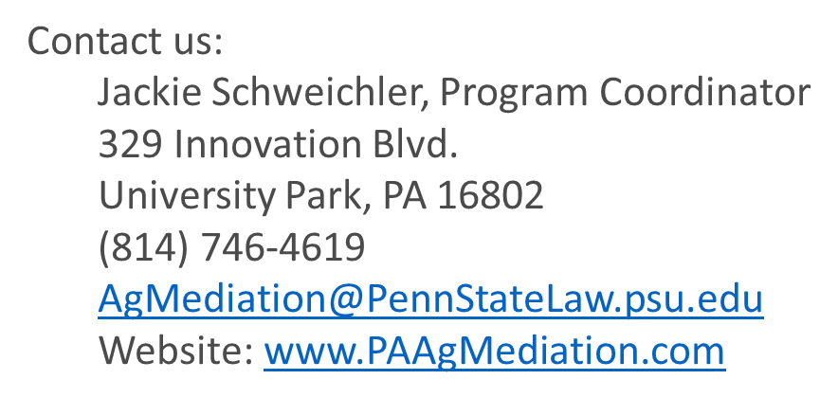
Pennsylvania Agricultural
Mediation Program
Who can request mediation?
  USDA-related issues:
    Agricultural Loans
    Wetlands determinations
    Compliance with farm programs, including conservation programs
    National organic program established under the Organic Foods Production Act of 1990
    Agricultural Credit
    Rural water loan programs
    Grazing on National Forest System land
    Pesticides
  Non-USDA issues:
    Land and Equipment Lease issues.
    Family farm transition.
    Farmer-neighbor disputes

Slide 8
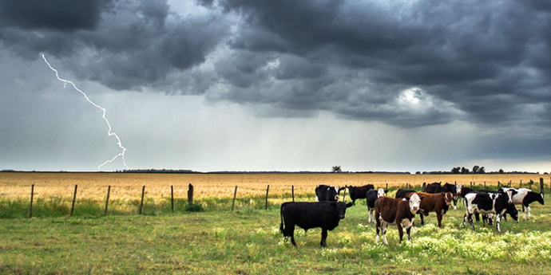
LIGHTNING ROUND

Slide 9
TOPICS - looking back and looking ahead, what are the dominant legal issues?
UPDATED LIST as of 12/2/21:
WORKFORCE ISSUES – Vaccination mandate
PESTICIDE SUITS & EPA RESPONSE(s) – Dicamba and Chlorpyrifos
CARBON CONTRACTS/MARKETS
STATE ANIMAL CONFINEMENT STANDARDS – Ca. Prop 12 upheld?
GRID-SCALE SOLAR PROJECTS ON FARMLAND
ANTITRUST IN THE PROTEIN SECTORS (BEEF, PORK, POULTRY)
MILK PRICING, DAIRY MARKET VOLATILITY
HEMP MARKET VIABILITY

Slide 10
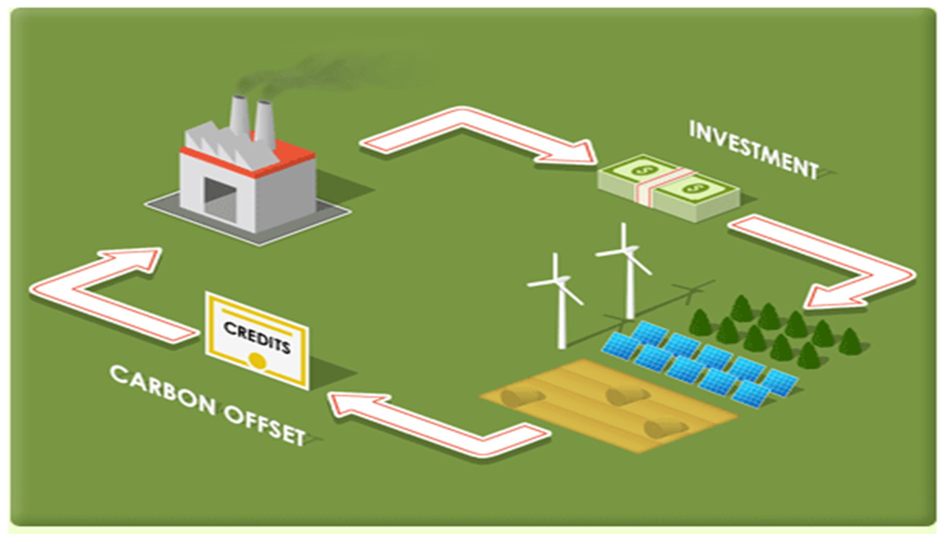
Carbon Contracts/Markets

Slide 11
CARBON MARKETS
Issue seemingly only emerged to prominence post-election 2020.
Just about every ag stakeholder has become involved in some fashion
Is this a reliable income source and how can producers proceed safely
Orderly market governance vs. a “wild west” scenario
When and how to get in – so may unanswered questions
S.1251 - Growing Climate Solutions Act of 2021

Slide 12
The Growing Climate Solutions Act of 2021
S. 1251 - U.S. Senate passed on 6/24/21 by vote of 92-8
Seeks to make it easier for farmers to participate in voluntary carbon credit markets.
Nothing is mandatory, completely voluntary.
USDA/EPA study of U.S. carbon markets:

Slide 13
Potential carbon credit generating activities:
Land or soil carbon sequestration.
Emissions reductions resulting from fuel choice or reduced fuel use.
Livestock emissions reductions, including emissions reductions achieved through (a) feeds, feed additives, and the use of byproducts as feed sources; or (b) manure management practices.
On-farm energy generation.
Energy feedstock production.
Fertilizer or nutrient use emissions reductions.
Reforestation.
Forest management, including improving harvesting practices and thinning diseased trees.
Preventing the conversion of forests, grasslands, and wetlands.
Restoring wetlands or grasslands.
Grassland management, including prescribed grazing.
Current practices associated with private land conservation programs administered by the USDA Secretary.
Other activities that the secretary, in consultation with the Advisory Council, determines to be appropriate.

Slide 14
What is in the proposed Act?
Establish voluntary USDA carbon saving measurement and verification protocols.
USDA also would establish an advisory committee to oversee operation of the USDA program to certify GHG technical assistance providers and third-party verifiers.
Creation of a USDA website where certified technical assistance providers and third-party verifiers would be listed.
Producer protection requirements that certified technical assistance providers and third-party verifiers would — “to the maximum extent feasible” — be required to follow.
  The providers and verifiers would be required to act in good faith, and to provide realistic estimates of costs and revenues relating to carbon saving activities and verification.
  Technical assistance providers would, in addition, be required to ensure — “to the maximum extent feasible” — that farmers and ranchers receive a fair distribution of revenues from the sale of ag carbon credits.

Slide 15
The questions to be asked with any carbon contract:
What will you be required to do to generate the credit (practices, etc.) – most will require new or different farming practices, such as no-till, cover crops, and replacing traditional fertilizer with soil amendments or the like. Other possibilities include transitioning to perennial crops or re-forestation.
How long will the contract last – these are likely to be long term, probably 10 years or much longer. The current marketplace is seeking long periods of carbon sequestration, some up to 100 years. The length of the contract will tie up the land’s use for significant periods, and likely impact sale and leasing opportunities. It may also impact transfers of the land through estate planning.
How much will you get paid – this should be a function of how much carbon will be captured on the land. It is difficult to determine current prices for carbon credit prices, but some indicators suggest prices of $5 to $9/ per metric ton. It will be important to know how many acres will be required to capture one ton of carbon.
When will you get paid – this is likely to be tied to the sale of the carbon credits by the aggregator and could be many months after the carbon-sequestering activities are completed. The practices required will probably incur some expense, or possibly a sacrifice in yield, so the payment will be used to counter the expense and hopefully result in profits. The landowner will also want to examine available options in the event of payment default.
What are the consequences of getting out of the contract – it is likely to be quite difficult to exit the contract since these are typically viewed as long-term arrangements. One comparable example would be early termination of a CRP contract – there the landowner is required to repay all of the CRP payments, plus interest and a penalty.
Will liens or restrictive covenants on placed on the land – the contract may allow the aggregator to place a lien or other restrictive covenant on the land to ensure compliance. This would greatly impact options for use and transfer of the encumbered acreage.
Who owns and gets access to the data – data regarding the land and practices will be collected by the aggregator to verify carbon storage. The data will also be communicated in some fashion to the marketplace to authenticate the carbon credit. The farmer will want to understand what data will be released and how.
How will the carbon be verified – the science of carbon verification is quite new, and its accuracy may be questionable. Current verification methods are time-consuming and expensive. This is likely to affect the value of the contract.
                Courtesy of Joel Cape, Cape Law Firm, PLC

Slide 16
RESOURCES
Aiken, J.D. “Ag Carbon Credits,” Cornhusker Economics, UNL Department of Agricultural Economics. April 21, 2021. Overview of ag carbon market.
https://agecon.unl.edu/ag-carbon-credits
Aiken, J.D. "Ag Carbon Offsets and the Carbon Bank" FARM Series 21-0312, UNL Department of Agricultural Economics. April 2, 2021. Provides introduction to ag credits as pollution offsets and to a possible USDA carbon bank, which is not part of S. 1251.
https://farm.unl.edu/policy-legal-finance/ag-carbon-offsets-and-carbon-bank/04022021-0956
Crespi, John M. & Kristin A. Tidgren. “The First Legal Step for an Agricultural Carbon Market is in the Growing Climate Solutions Act of 2021.” May 2021. Compares the proposed Growing Climate Solutions Act to USDA regulation of organic food. 5 page report. https://www.card.iastate.edu/products/publications/synopsis/?p=1325
Plastina, Alejandro & Oranuch Wongpiyabovn. “How to Grow and Sell Carbon Credits in US Agriculture.” Iowa State University Extension & Outreach, July 2021. Very helpful report comparing 11 private voluntary ag carbon programs across 26 factors. https://www.extension.iastate.edu/agdm/crops/pdf/a1-76.pdf
Sellars, Sarah and others. “What Questions Should Farmers Ask about Selling Carbon Credits?” Farmdoc Daily (11):59, Department of Agricultural and Consumer Economics, University of Illinois at Urbana- Champaign, April 13, 2021. Excellent bulletin that estimates per acre revenue for several carbon saving ag activities. https://farmdocdaily.illinois.edu/2021/04/what-questions-should-farmers-ask-about-selling- carbon-credits.html
Swanson, Krista and others. "Growing Climate Solutions Act Impact on Farmers." farmdoc daily (11):66, Department of Agricultural and Consumer Economics, University of Illinois at Urbana-Champaign, April 22, 2021. Overview of carbon markets; short discussion of the Growing Climate Solutions Act. 3 page newsletter. https://farmdocdaily.illinois.edu/2021/04/growing-climate-solutions-act-impact-on- farmers.html

Slide 17
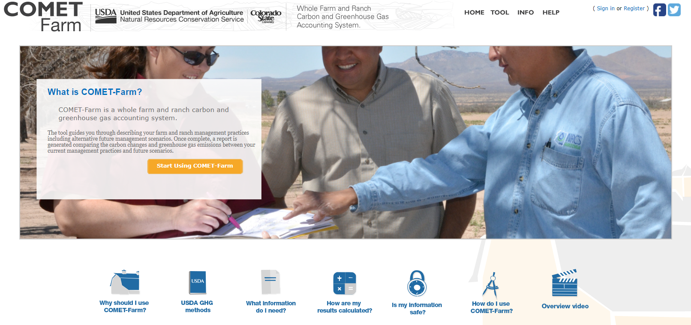
COMET- Farm -- Whole Farm and Ranch Carbon and Greenhouse Gas Accounting System

Slide 18
Center Resources – aglaw.psu.edu
Carbon Markets
  Agricultural Law in the Spotlight – (coming soon)
  Agricultural Law Weekly Review
  Agricultural Law Podcast

Slide 19
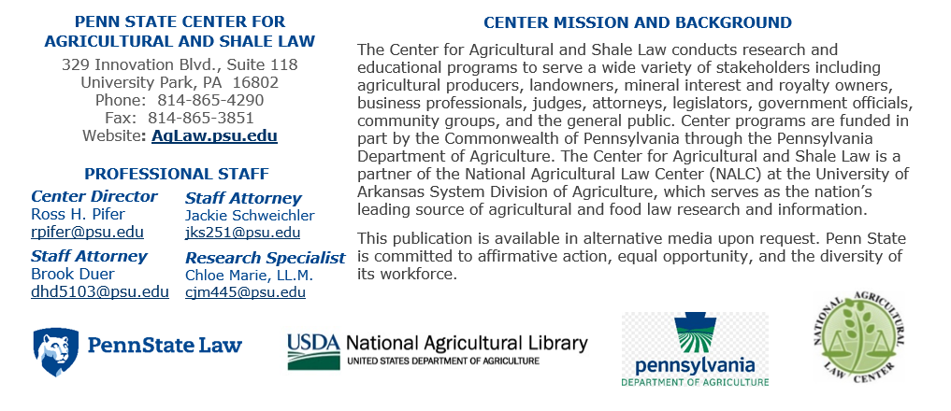

Slide 20




Thanks to Our Partners
The Center for Agricultural and Shale Law is a partner of the National Agricultural Law Center (NALC) at the University of Arkansas System Division of Agriculture, which serves as the nation’s leading source of agricultural and food law research and information. This material is provided as part of that partnership and is based upon work supported by the National Agricultural Library, Agricultural Research Service, U.S. Department of Agriculture.

Slide 21
EXTRA SLIDES ON ALTERNATIVE TOPICS

Slide 22
DICAMBA DRAMA
Litigation leads to unprecedented loss of registration mid-season 2020
New 5-year registration issued on eve of the election
Litigation resumes; consolidated at D.C. Circuit Court
Political interference in EPA science/decision-making confirmed
What and when will D.C. Circuit rule?
  How will the result impact the massive investment in development, seed, product?

Slide 23
STATE ANIMAL CONFINEMENT STANDARDS
Will the Commerce Clause stop a state-government’s animal confinement mandate from prohibiting in-state sales of non-compliant out-of-state product?
CA Prop 12 appeal is before to the U.S. Supreme Court, effective date remains 1/1/22.
Whatever becomes the final legal result of the challenges to CA Prop 12, it will likely impact all cage-free egg laws and all other animal confinement standards in every state where enacted, plus many other areas of agricultural regulation.

Slide 24
GRID-SCALE SOLAR DEVELOPMENT
Landowners are being inundated with options/leases
Not just PA, every state
It is a speculative development boom; but is there really a downside if the terms are properly negotiated?
Absence of PA state government voice on siting (or much else)
Local municipal government boards are presently the “regulator of first instance”
Will state government policy emerge that impacts the boom?
No control over siting seems inconsistent with PA’s massive investment in farmland preservation measures.

Slide 25
WORKFORCE ISSUES
OSHA Emergency Temporary Standard stayed by federal courts
  Prospects of surviving legal challenge seem slim at this point
New H-2A Final Rule stranded by EO regulatory freeze
  overhaul of H-2A regulations does contain important revisions
Farm Workforce Modernization Act of 2021
  Will it ever be taken up in the US Senate?
COVID-19 & EEOC Compliance
  How can employers best manage their workforce, medical info and vaccination issues?

Slide 26
OSHA Emergency Temporary Standard
Executive Order on Protecting Worker Health and Safety – 1/21/21
  OSHA shall consider whether any EMERGENCY TEMPORARY STANDARDS (ETS) are necessary & issue any by March 15, 2021.
March 15, 2021, came and went; April 26, 2021, US DOL submits an ETS to White House for review.
Will the so-called “OSHA Exemption” for small farms be addressed?
  <10 employees and no employer-supplied housing
COVID 19: OSHA Vaccination Mandate Issued and Immediately Stayed by Federal Court
  On November 5, 2021, the U.S. Department of Labor (DOL), Occupational Safety and Health Administration (OSHA) published in the Federal Register, “COVID-19 Vaccination and Testing; Emergency Temporary Standard (86 FR 61402), an interim final rule that consists of an emergency temporary standard (ETS) immediately effective requiring employers of 100 or more employees by December 5, 2021, to “develop, implement, and enforce a mandatory COVID-19 vaccination policy, with an exception for employers that instead adopt a policy requiring employees to either get vaccinated or elect to undergo regular COVID-19 testing and wear a face covering at work in lieu of vaccination.”

Slide 27
COVID 19: OSHA Vaccination Mandate Issued and Immediately Stayed by Federal Court (cont.)
A public comment period on the ETS closes on December 6, 2021. Information is available on OSHA’s dedicated webpage about the ETS, including webinars, FAQs and employment policy templates.
The ETS does not mention the so-called “agricultural exemption” from OSHA enforcement for employers with 10 or less employees and no employer-supplied housing. However an OSHA ETS could not legally supersede that act of the U.S. Congress.
That same day, multiple legal challenges, which included emergency motions requesting the ETS be stayed temporary and permanently, were filed by numerous parties, including state governments and state attorneys general, in numerous federal courts across the country.
On November 6, 2021, the United States Court of Appeals for the Fifth Circuit, located in New Orleans, Louisiana, entered an order stating, “Because the petitions give cause to believe there are grave statutory and constitutional issues with the [ETS], the [ETS] is hereby STAYED pending further action by this court.” BST Holdings, et. al, v. OSHA, et. al, No. 21-60845.

Slide 28
COVID-19: Federal Courts Affirm Stay and Consolidate Cases Challenging OSHA’s Vaccination and Testing Emergency Temporary Standard
On November 12, 2021, the U.S. Court of Appeals for the Fifth Circuit issued an opinion reaffirming the court’s November 6, 2021 temporary stay of the U.S. Department of Labor (DOL) Occupational Safety and Health Administration’s (OSHA) November 5, 2021 COVID-19 Vaccination and Testing Emergency Temporary Standard (86 FR 61402). BST Holdings v. OSHA, No. 21-60845.
OSHA’s “Emergency Temporary Standard” webpage now states that, although the agency “remains confident in its authority to protect workers in emergencies, OSHA has suspended activities related to the implementation and enforcement of the ETS pending future developments in the litigation.” Those further developments will include disposition of a motion for a permanent injunction against the ETS.
On November 16, 2021, the United States Judicial Panel on Multidistrict Litigation ordered that all further legal proceedings in twelve separate legal challenges to the ETS filed in the twelve U.S. Circuit Courts of Appeals shall be decided in one consolidated case and decided by the Sixth Circuit Court of Appeals. For more, see ALWR—Nov. 5, 2021, “OSHA Vaccination Mandate Issued and Immediately Stayed by Federal Court.”

Slide 29
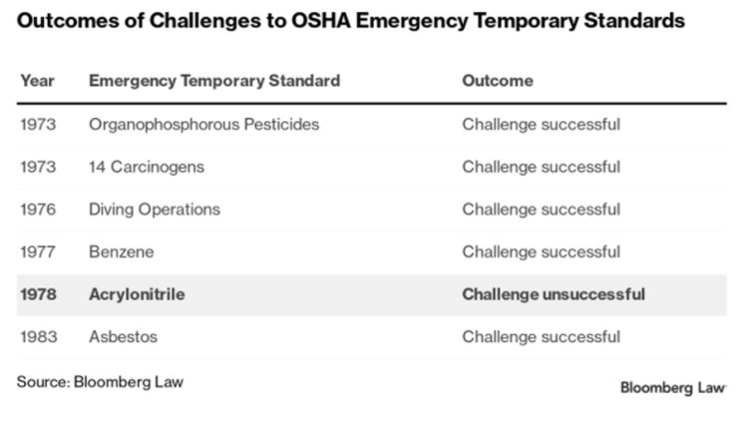
OSHA ETS have not fared well historically
OSHA is authorized to issue and ETS only if doing so is “necessary to protect workers from grave danger.” The agency has issued nine emergency temporary standards in its 30-year history. The most recent was in 1983. Six of the nine emergency standards that were issued also were challenged in court. Of those six, only one was allowed to go into effect.

Slide 30
New H-2A Final Rule stranded
DOL Issues Final H-2A Rule but it is subject to Regulatory Freeze EO
On January 15, 2021 the U.S. Department of Labor (DOL) Employment and Training Administration announced the forthcoming publication of a final rule titled “Temporary Agricultural Employment of H-2A Nonimmigrants in the United States.” The final rule requires job orders and applications to be filed electronically, allowing DOL to share information with the Department of Homeland Security and other federal agencies, and allows employers without full-time work offerings to file a single application for joint employment to provide full-time work. The rule also allows employers to stagger the entry of H-2A workers into the country over 120 days and permits state and federal authorities to conduct inspections of employer-provided housing for up to twenty-four months. For more on the July 26, 2019 proposed rulemaking, see ALWR—August 1, 2019, “Department of Labor Proposes Changes to H-2A Program.”

Slide 31
COVID-19 & EEOC Compliance
What You Should Know About COVID-19 and the ADA, the Rehabilitation Act, and Other EEO Laws - Technical Assistance Questions and Answers – Last updated on November 17, 2021
  A quick review of this document reveals the many sticky questions that may arise in handling COVID-19 in the workplace. This is one area where an employee’s medical information can be relevant and an employer may inquire/possess information that is not customary.
Answers: Employer vaccination mandates, employer incentives, handling of accommodations for ADA-protected reasons or religious belief

Slide 32
H.R.1603 - Farm Workforce Modernization Act 2021
Passed House (260-165) and died in Senate in 2019. Reintroduced 3/8/21 and passed House 3/18/21 (247-174).
Establishes a certified agricultural worker (CAW). DHS may grant CAW status to an applying alien who:
  (1) performed at least 1,035 hours of agricultural labor during the two-year period prior to March 8, 2021;
  (2) on that date was inadmissible, deportable, or under a grant of deferred enforced departure or temporary protected status; and
  (3) has been continuously present in the United States from that date until receiving CAW status.
CAW status valid for 5.5 years and may be extended; can grant dependent status to spouse/children of a principal alien.
No DHS detention or removal and authorized for employment until application final decision.
A process established for CAW (and dependents) to apply for permanent resident status.
DHS electronic platform for (1) filing H-2A petitions, (2) processing of H-2A cases, and (3) agencies share the data docket
DHS pilot program allowing “portable” status to “string together” multiple jobs and staying in the country.
DHS electronic system patterned on the E-Verify Program for mandatory employer verification in hiring,
Various H-2A program changes: (1) H-2A worker minimum wage calculation revised; (2) modifies reporting of U.S. workers recruitment efforts; (3) guaranteed minimum work hours, (4) program available for agricultural work that is not temporary or seasonal, and (5) reserving a visa allocation for the dairy industry.

Slide 33
US DOL’s Wage and Hour Division’s
Agriculture Compliance Assistance Toolkit
Cultivating Compliance – A comprehensive guide to labor law compliance specifically for employers of agricultural workers.
Cultivating Compliance: – Your Next Steps as a Registered Farm Labor Contractor (FLC) – A guide to MSPA’s requirements for certified farm labor contractors.
Migrant and Seasonal Agriculture Worker Protection Act (MSPA) poster – Required for employers of farm labor workers.
H-2A Program poster – Required for employers of workers on H-2A visas.
Poster: Agriculture under the Fair Labor Standards Act
Agricultural Fact Sheets
  Wage and Hour Fact Sheet 49: The Migrant and Seasonal Agricultural Worker Protection Act
  Wage and Hour Fact Sheet 50: Transportation under the Migrant and Seasonal Agricultural Worker Protection Act
  Wage and Hour Fact Sheet 51: Field Sanitation Standards under the Occupational Safety and Health Act
Agricultural Employer’s Pocket Guide to Youth Employment

Slide 34
Center Resources – aglaw.psu.edu
Workforce Issues
  COVID-19 Issue Tracker
  H-2A Program Issue Tracker
  Agricultural Law Weekly Review
  Agricultural Law Podcast

Slide 35
Dicamba Drama Recap & New Rules
6/3/20 - Ninth Circuit Court invalidates three 2018 registrations (XtendiMax, Engenia and FeXapan).
10/27/20 - EPA approves 3 new 5-year registrations (XtendiMax, Engenia, Tavium). (2/21/21 Corteva discontinues FeXapan)
12/21/20 - Same parties appeal on same grounds; other suits filed; all transferred and consolidated in D.C. Circuit.
3/10/21 - EPA admits political interference in 2018 approvals; 5/24/21 confirmed by EPA Inspector General report.
New Rules:
For use with “dicamba-tolerant” soybean and cotton only; Can apply only in 34 enumerated states.
Registrations expire on Dec. 20, 2025
Prohibit soybean application after June 30 annually (cotton - after July 30)
Require the dicamba products to be tank-mixed with a “pH-buffering agent” and that producers maintain a 240-foot “downwind buffer” and a 310-foot buffer in “listed species” locations (plus training requirements)
Prohibit application during temperature inversions and at any time other than between one hour after sunrise and two hours before sunset
Big Questions: Will the D.C. Circuit Court wait to decide the case until winter? Seems very likely. What impact from other pesticides cases coming from federal courts that have been extremely critical of EPA actions (Chlorpyrifos, Glyphosate)

Slide 36
Center Resources – aglaw.psu.edu
Dicamba / Pesticides
  Dicamba Issue Tracker
  Glyphosate Issue Tracker
  2021 PA Farm Show Agricultural Law Symposium
    Hour 4: Pesticide Drama & Non-Target Liability video
  Agricultural Law in the Spotlight – U.S. Court of Appeals Issues Two Separate Decisions in Pesticide Cases
  Agricultural Law Weekly Review
  Agricultural Law Podcast

Slide 37
Status of CA Proposition 12 Legal Challenge
Will the Commerce Clause prevent a state-government’s animal confinement mandates from prohibiting in-state sales of non-compliant out-of-state product?
Animal Welfare: U.S. Supreme Court Petitioned to Accept Appeal Challenging Constitutionality of California’s Proposition 12
On September 27, 2021, the National Pork Producers Council (NPPC) and American Farm Bureau Federation (AFBF) filed a petition for writ of certiorari in the U.S. Supreme Court seeking to have California’s Proposition 12 declared unconstitutional as a violation of the U.S. Constitution’s Commerce Clause. Proposition 12 in pertinent part prohibits the in-state sale of pork products from animals raised in a manner not compliant with California’s in-state swine confinement standards. National Pork Producers Council, et al. v. Karen Ross, No. 21-468. The law was upheld as constitutional by the U.S. Court of Appeals for the Ninth Circuit in July 2021. NPPC and AFBF’s announcement states that the Court is being asked to determine whether a state law that “requires pervasive changes to an integrated nationwide industry” and thus imposes “dramatic economic effects largely outside of the state” is a dormant Commerce Clause violation, i.e. it unreasonably burdens interstate commerce. If the U.S. Supreme Court agrees to hear the appeal, its decision on the constitutionality of the law will likely be rendered in mid-2022, six months or more after Proposition 12’s effective date of January 1, 2022. If the U.S. Supreme Court declines to hear the case, that is likely to be well before January 1, 2022. For background, see ALWR—July 30, 2021, “Federal Appeals Court Upholds California’s Proposition 12 With Five Months Until Its Effective Date.”

Slide 38
Center Resources – aglaw.psu.edu
State Animal Confinement Measures
  State Animal Confinement Measures Issue Tracker (coming soon)
  2021 PA Farm Show Agricultural Law Symposium
    Hour 1: Agricultural Law Update
  Agricultural Law Weekly Review
  Agricultural Law Podcast

