Slide 1
Utility Scale Solar Leasing: How It Works and When It Doesn’t
Agricultural Law Symposium
Tuesday, January 12, 2021 , 2:15 PM - 3:15 PM EST

Slide 2
Thanks to Our Partners
Programs of the Center for Agricultural and Shale Law are supported by:
The National Agricultural Law Center
National Agricultural Library
Pennsylvania Department of Agriculture

Slide 3
RECAP of Solar Webinars to date:
All are viewable here: https://extension.psu.edu/energy/renewable-and-alternative-energy/see-all-renewable-and-alternative-energy/shopby/webinars
April 16 - Energy Markets Domestically and Globally
April 22 - Solar Leasing for Landowners
June 17 – Utility Scale Solar Development
July 8 – Large Scale Solar Development for Landowners

Slide 4
July 23 - Prices and Economics of Solar Leasing in Pennsylvania
July 29 - Solar Development Trends in the Mid-Atlantic States – Factors Driving their Deployment
Aug 5 - Solar Energy Development in Pennsylvania - What's Currently Happening and What's Expected
Aug 12 - Solar Energy and Land Use – Designing a Sustainable Outcome
Sept 9 - Solar Leasing by Landowners for Utility Scale Projects in Pennsylvania
Sept 23 - Utility Scale Solar - Land Use, Policy and Emerging Ordinances - An Interactive Q and A

Slide 5
Agenda
Amanda Eyer (PA DEP Energy Program Specialist)
Overview of Solar in PA – 10 mins
Brook Duer
Solar Leasing Basic Principles & Leases – 30 mins
Doug Wolfgang (PDA Director - Farmland Preservation Bureau)
Competing Governmental Interests – 15 mins

Slide 6
4 Basic Introductory Principles
This is an industry in its infancy.
This transaction is a commercial lease, on steroids.
The tenant has some unique needs to understand.
This is a long-term business relationship to maintain.

Slide 7
1. This is an industry in its infancy.
The documents being proposed are not battle-tested by use over decades. This is a new industry, with new documents.
Landowners should not sign the developer's forms as-is. There can be many provisions that must be revised for landowners.
Few things are off-limits for negotiation because “deal-breakers” have not yet been established.
Landowners won't be able to negotiate the contract details themselves and will need an attorney. There are few attorneys who have seen these forms before.
But the concepts involved are not overly complex from an attorney’s perspective. An attorney who negotiates commercial leases will be familiar with the basic concepts.

Slide 8
2. The transaction is a commercial lease, on steroids.
This is a leasing transaction, much like other commercial leases. But an average landowner is not used to being a commercial landlord. This is not a farming tenant or a utility easement or a right of way.
There are legal considerations that a landowner may never have encountered before due to the sophisticated tenant and transaction being dealt with.
Term: The lease may last as long 50 years.
Permanent Structures: The tenant is building structures on another’s property which are permanent. (Although they do not become “fixtures” owned by the landlord.)
One novel legal concept is the “solar easement” over the landowner’s surrounding acreage. Otherwise, there are few unique concepts like royalties or subsurface rights.

Slide 9
3. The tenant has some unique needs to understand.
The permanent structures have comparatively greater access, maintenance and transmission requirements.
The structures, and the income stream they produce, are going to be used as collateral to obtain financing. This means the tenant’s ability to continue conducting its activity on the land must not be interfered with by any entity who holds a previously-recorded or superior property interest in the land (e.g. your mortgage holder).
All the lease documents will be recorded. The tenant may need “superior” liens or interests “subordinated.”
The structures may be sold during the lease term, perhaps multiple times. The ability of the tenant to assign the lease without landowner approval will be one non-negotiable term.

Slide 10
4. This is a long-term business relationship to maintain.
There will likely be several tenant identity changes over the term of the lease and, correspondingly, perhaps some changes in ownership on the landowner side also. Plan and think ahead because this lease impacts heirs and any subsequent owners. It also can impact future property value.
Property tax obligations will be a shared responsibility for the duration of the lease. The documents being used commonly agree that the tenant pays any increased property taxes for the entire term.
The landlord needs to ensure that the tenant maintains the required liability insurance for the landlord’s protection for the entire term.
“Decommissioning” obligations to remove all equipment and restore the property need to be negotiated and established now, in detail, for an event that may not occur for several decades.

Slide 11
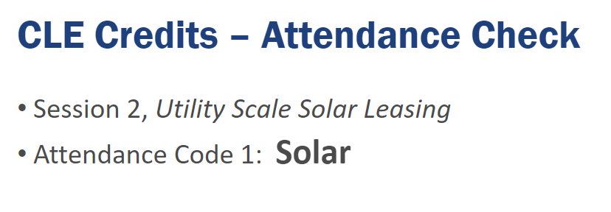

Slide 12
The Two Parts of a Solar Development Lease
Preliminary Letter of Intent: Sometimes there is even a preliminary "Letter of Intent" document, which can be simply a 1-page form. The primary reason for this is to get the landowner to sign a confidentiality clause so that future terms, especially monetary, are not disclosed to others.
Sometimes the documents omit that disclosure must be allowed to attorneys, accountants, advisors, family members, mortgage and other competiting property interest holders and municipal/government officials, all as necessary to proceed with the project.
1. Option Agreement – approx. 10-15 pages
2. Lease Agreement – approx. 40-60 pages (attached to the Option Agreement)
A landowner can't sign the Option Agreement without also negotiating the terms of the Lease Agreement in its entirety. So all the hard work from the landowner end is up front.

Slide 13
1. Option Agreement - Locks in a due diligence period of 1-5 years during which the solar developer decides if it wants to proceed.
$$$ to landowner for development exclusivity, access rights to investigate the site & confidentiality.
”Feasibility Study” / The developer obtains a full title report, full survey, other leases, etc.
The developer is weighing all circumstances to determine viability -- financially and otherwise.
No ground is broken; all costs incurred are on the developer. Landowner can still farm, etc.
If the developer decides to proceed, the landowner cannot back out. The option is unilateral.
2. Lease Agreement - If the solar developer decides to proceed, the Lease Agreement is sent to the landowner to sign in a defined period of days. There is no chance to renegotiate terms. (Sometimes leases of this nature are called a “Ground Lease.”)

Slide 14
Timeline of the Lease Term
Option Effective Date (signature on Option Agreement, $$ is paid)
Option Phase
Lease Effective Date (signature on Lease Agreement, $$ is paid)
Construction Phase (the build out – may be a reduced rent amount)
Operational Phase (energy generation – the full rent is paid)
Renewals (if any) may be exercised
Cleanup Phase (removal and restoration – $$ still owed, creates leverage to complete)
Termination Date

Slide 15
Consideration of Competing Legal Interests
The landowner may have “encumbered” the property in various ways, through such things as:
mortgages, other liens or leases, rights of way and easements, enrollment in various governmental programs such as Clean & Green (preferential property tax assessment), FSA/NRCS administered programs with conservation practices requirements, or even an agricultural conservation easement or private conservation easement.
Before signing, a landowner must consider how these interests will be impacted by a solar lease, and how their existence will impact a developer’s decision to proceed.
The Lease documents generally agree, or it can be negotiated, that the developer pays any financial losses caused by the solar lease’s impact upon competing legal interests. But some conflicts with competing legal interests cannot be resolved financially.
During the Option Phase, the developer is also analyzing these same competing legal interests to determine the location’s viability.

Slide 16
Competing Legal Interests
Existing Mortgage or other Monetary Liens
Talk with the creditor, if possible.
The Lease documents require "Subordination Agreements" signed by the creditor, at the developer’s request, to make a mortgage or other lien “subject to the lease” so the solar tenant is not evicted in the event of foreclosure.
Existing Leases - Negotiate a buy-out of the tenant, paid by the developer?
Agricultural Conservation Easements - If PA government purchased, solar leasing is not permitted.
Privately-purchased Conservation Easement - Depends upon the terms, but highly unlikely that solar leasing is permitted. Can solar leasing be negotiated?

Slide 17
Competing Legal Interests
Other types of recorded or unrecorded interests:
Hunting Lease – stray rounds will be a problem.
Subsurface Rights – will future subsurface rights development interfere?
Existing Easements – could conflict with the developer’s needs.
utilities, stormwater, access/roads
Enrollment in Government Programs
PA’s Clean and Green property tax assessment program does not allow, unless at least 50% of energy is used on-site. Roll-back taxes will be owed, but most leases provide that the developer pays them.
FSA/NRCS programs – solar leasing is too new for definitive answers. Check with the entities involved. Likely answer is no.

Slide 18
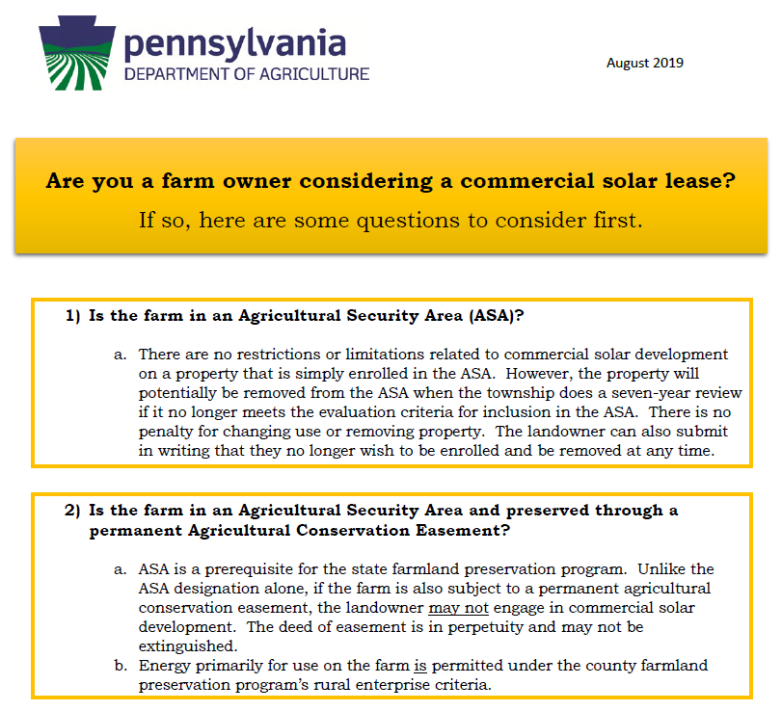
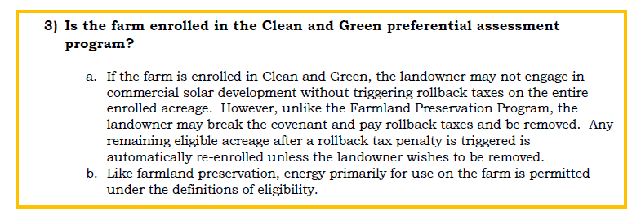
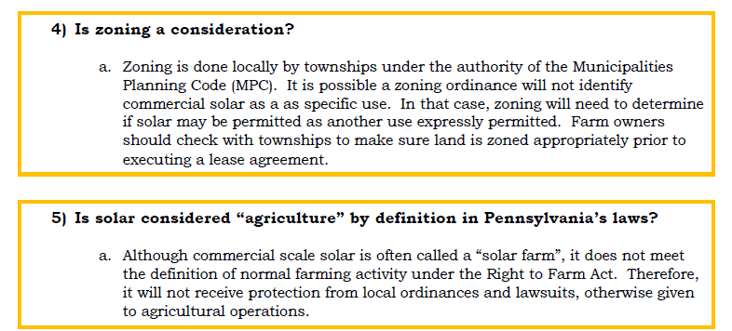

Slide 19
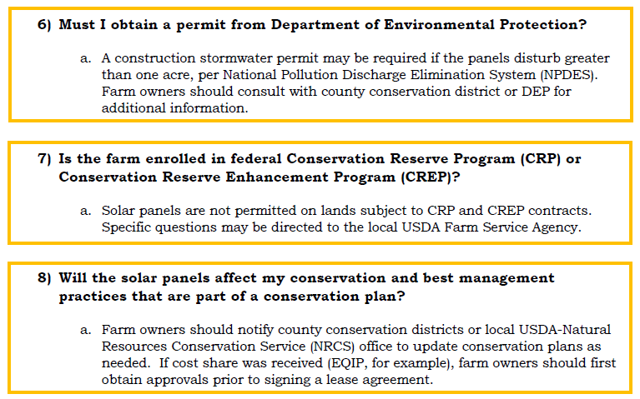

Slide 21
Zoning Approval of the Land Use
Zoning Approval is largely uncharted territory.
PA zoning ordinances, unless very recently amended to account for solar leasing as a use in the township, will require approval of solar leasing through a conditional use application to the township supervisors (not the zoning hearing board). (“Uses not otherwise provided for”)
“Conditions“ can be attached and presently there are no controls over how extensive or on what subject matters those conditions may be. That raises the undetermined legal question of whether, and to what extent, townships will "regulate" solar generation facilities. DEP is not already involved; FERC is the regulatory entity, not PA Public Utility Commission.
The lease documents agree that the developer is 100% responsible for getting zoning approval (as well as all other government approvals) but do require landowner assistance.

Slide 22
Contract Terms & Conditions
Legal Description and Plot Plans: Attachments to the Option and Lease. Be attentive to potential difference between the total acreage of the Option and the ultimate acreage of the Lease itself. This is one provision that will be undetermined until the Option is exercised and the Lease tendered for signature. The final “configuration” is not determined at the outset.
Appurtenant Facilities: There are more than just solar panels. Transmission and distribution equipment, sub-station, batteries, overhead or underground lines, buildings, roads, yards, fences, etc.

Slide 23
Contract Terms
Accompanying Easements: The leased acreage is for actual solar operation, but the lease also grants the tenant various other easements.
Construction Easement – temporary.
Access Easement – for routine access during the lease term.
Transmission Easement – for transmitting power to the grid.
Solar Easement – unobstructed access to the sun.

Slide 24
Contract Terms - example
General “Non-Interference” Clauses & Curative Agreements

Slide 25
Contract Terms
Insurance – Tenant must purchase & maintain liability insurance naming the Landowner as an additional insured on the policy for the life of the Option and Lease. Tenant's policy must be primary coverage and on an “Occurrence Basis.”
Indemnity - Tenant must indemnify landowner for any costs, losses, liabilities arising from tenant’s activities on site. Needs to be all encompassing.

Slide 26
Contract Terms
Maintenance is 100% on the developer.
(don’t volunteer sheep to “mow”)
Does landowner want control over:
herbicides/pesticides/fungicides being used?
ground cover on the leased area?
Does landowner need access to the leased area? Normally a leased premise is 100% in the tenant's exclusive possession.
Should the tenant contribute to maintenance of any shared acreage over which the tenant possesses an easement?
Built-in remedies for failure to maintain?
Reserved Uses? Is there some unique desire of the landowner?

Slide 27
Contract Terms Example of a “$$$ matching” term for Option payments

Slide 28
Contract Terms
“Mortgagee Protection” clauses
The landowner (or its creditors) may be asked to copy the secured creditor of the tenant on communications like notices of default. The loan collateral could be in jeopardy without the secured creditor’s knowledge.
Termination
By Tenant –”for convenience” by paying all rent owed to date only (and proceeding with removal/restoration obligations).
By Landlord – This is where things can get complicated. Bankruptcies and insolvencies seem likely in this “industry in its infancy.” Bankruptcy trustees don’t make anything easy, even if bankruptcy is an “event of default.” Most likely the contractual rights and assets will be purchased and there will be a new tenant be out some degree of rent. “Forfeiture” of property (the structures) upon default is “non-negotiable.”
Condemnation – jointly divide the award between value attributable to “improvements” (tenant) and to “real estate” (landlord).

Slide 29
Restoration (“Decommissioning”)
At termination, “surrender possession” and execute any documents needed.
Restoration Term – ex: 12 months to remove above grade, and at least 3-foot below grade, improvements and restore to pre-lease condition. Pay rent at construction phase amount during restoration? Negotiate option to retain roads, etc.?
Bond/Financial Security – What will be the cost to remove 30 years from now?

Slide 30
THANK YOU!
Brook Duer
Staff Attorney
Center for Agricultural and Shale Law
Penn State Law
329 Innovation Boulevard, Suite 118
University Park, PA 16802
(814) 863-3396
dhd5103@psu.edu

